Slide 1
Managing patients with dyslipidaemia
How to tackle
clinical inertia

Slide 2
This recorded INDUSTRY q&a SESSION specifically intended for healthcare professionals (HCPs) is sponsored by Sanofi on the occasion of ESC Congress 2020 – The Digital Experience, Saturday 29 August–Tuesday 01 September 2020. Individual medicinal products that may be referred to during this INDUSTRY SESSION may not be authorised/licensed in all countries. Content has been developed, where applicable, consistent with the EU Summary of Product Characteristics (SmPC). Please consult prescribing information in your country of practice current to date of viewing this content, in respect to medicinal products mentioned as information may vary from country to country.

Slide 3
A closer look at managing very high-risk dyslipidaemic patients
Prof J Wouter Jukema (The Netherlands)

Slide 4
DISCLOSURES
Professor Jukema reports receiving research grants from the Netherlands Heart Foundation, the Interuniversity Cardiology Institute of the Netherlands and the European Community Framework KP7 Program, and has received other research support from Amgen, Astellas, AstraZeneca, Daiichi-Sankyo, Lilly, Merck-Schering-Plough, Pfizer, Roche and Sanofi.

Slide 5
Ldl-c levels and cvd risk reduction
Evidence that plasma LDL-C concentration is strongly associated with dose-dependent increase
in ASCVD risk is provided by
meta-analyses of:
  randomised controlled trials
  prospective cohort studies
  and Mendelian randomisation studies
LDL-C is seen to have a causal and a cumulative effect on the risk of CVD, demonstrated by the increasingly steep gradient of the log-linear association with increasing length
of follow-up time
80%
Mendelian randomisation studies
Median follow-up: 52 years
(N=194,427)
60%
Prospective cohort studies
Median follow-up: 12 years
(N=403,501)
Proportional reduction in risk of CHD
50%
40%
30%
20%
Randomised controlled trials
Median follow-up: 5 years
(N=196,552)
10%
0
0.0
0.2
0.4
0.6
0.8
1.0
1.2
1.4
1.6
1.8
2.0
Magnitude of exposure to lower LDL-C (mmol/L)
ASCVD, atherosclerotic cardiovascular disease; CHD, coronary heart disease; CVD, cardiovascular disease;
ESC, European Society of Cardiology; HCP, healthcare professional; LDL-C, low-density lipoprotein cholesterol.
Ference BA, et al. Eur Heart J. 2017;38(32):2459–72.

Slide 6
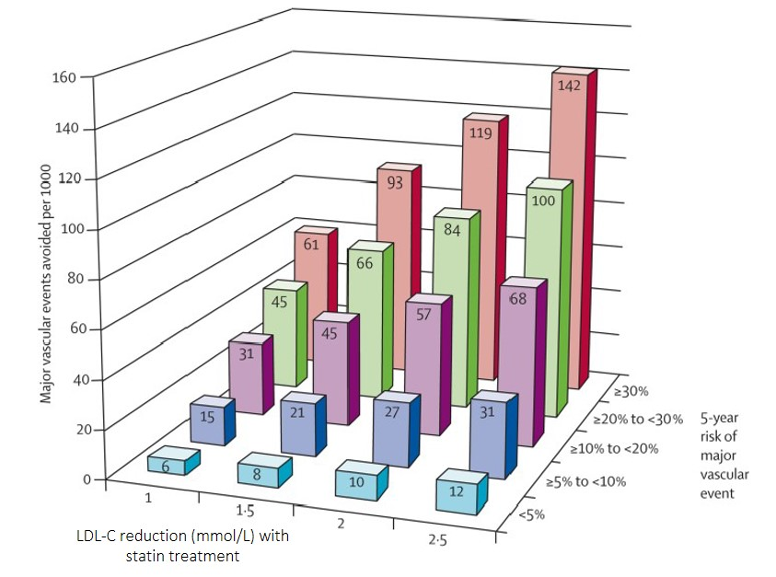
CTTC: REDUCTION OF LDL-C WITH STATINS REDUCED THE RISK OF MAJOR VASCULAR EVENTS
Study design: A meta-analysis by the CTT included individual patient data from 22 trials of statin versus control (n=134,537; mean LDL-C difference 1.08 mmol/L; median follow-up 4.8 years) and five trials of more versus less statin (n=39,612; difference 0.51 mmol/L; 5.1 years)ª
Results:
Reduction of LDL-C with statins reduced the risk of major vascular events (RR, 0.79; 95% CI: 0.77–0.81; per 1.0 mmol/L reduction)
  There was no evidence that a reduction of LDL-C with statins increased cancer incidence, cancer mortality or other non-vascular mortality
  Higher absolute risk = greater absolute reduction = lower NNT
In these individuals, each 1 mmol/L reduction in LDL-C produced
an absolute reduction in major vascular events of about 11 per 1,000 over 5 years. Benefits of LDL-C reduction through statin therapy
exceed any known hazards
ªMajor vascular events were major coronary events, strokes or coronary revascularisations.
CTTC, Cholesterol Treatment Trialists’ Collaboration; CI, confidence interval; NNT, number needed to treat; RR, risk reduction.
Cholesterol Treatment Trialists' (CTT) Collaborators, et al. Lancet. 2012;380(9841):581–90.

Slide 7
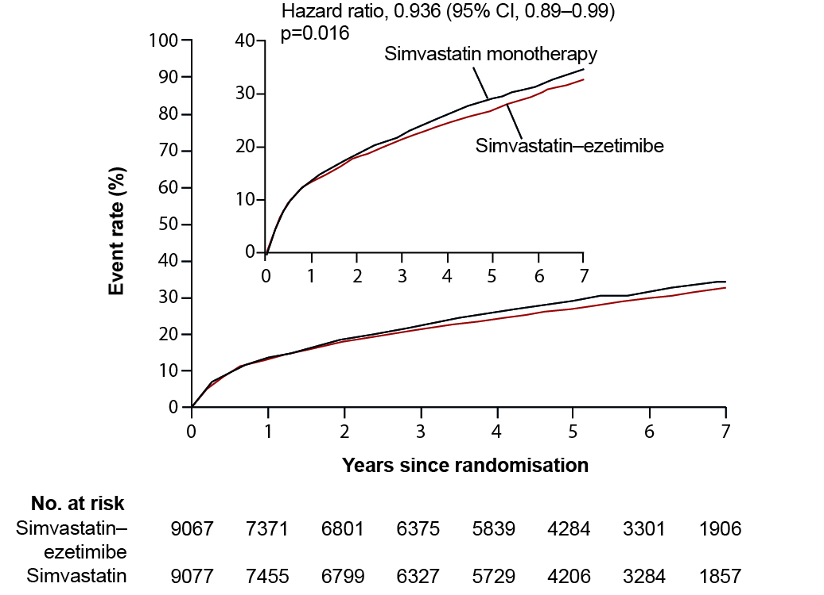
IMPROVE-IT: The addition of ezetimibe to statins significantly reduced CV risk
Study design
Kaplan–Meier curves for the primary efficacy endpoint
Simvastatin
40 mg
Ezetimibe/simvastatin
10/40 mg
Follow-up visit at Day 30 every 4 months
Duration: minimum 2.5 years’ follow-up
(at least 5,250 events reached)
Primary endpoint: CV death, coronary revascularisation or non-fatal stroke
The addition of ezetimibe to statin therapy resulted in the reduction of LDL-C levels by approximately 24%. Combination of ezetimibe
and simvastatin also resulted in a significant reduction in CV risk. No significant difference in adverse side effects
CV, cardiovascular; IMPROVE-IT, IMProved Reduction of Outcomes: Vytorin Efficacy International Trial.
Cannon CP, et al. N Engl J Med. 2015;372(25):2387–97.

Slide 8
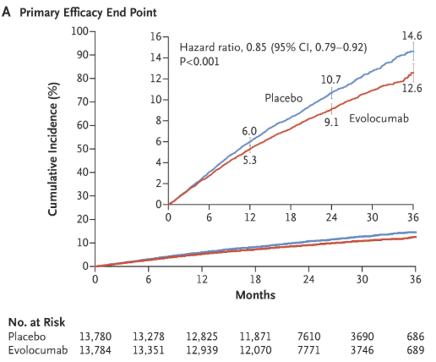
FOURIER: Addition of PCSK9i to background statin therapy further reduces MACE
Study design¹
Primary efficacy endpoint^{2a}
27,564 high-risk, stable patients with established CV disease (prior MI, prior stroke or symptomatic PAD)
Screening, lipid stabilisation, and placebo run-in
High- or moderate-intensity statin therapy (±ezetimibe)
LDL-C ≥70 mg/dL (1.8 mmol/L) or
non-HDL-C ≥100 mg/dL (2.6 mmol/L)
Randomised
Double-blind
Evolocumab SC
140 mg Q2W
or 420 mg QM
Placebo SC
Q2W or QM
Follow-up: Weeks 2, 4, 12, and thereafter at 12-week intervals
Safety: No significant between-group differences were found in the overall rates of adverse events, serious adverse events, or adverse events thought to be related to the study agent and leading to discontinuation of treatment
ªPrimary efficacy endpoint (composite of CV death, MI, stroke and hospitalisation for unstable angina, or coronary revascularisation).
HDL-C, high-density lipoprotein cholesterol; MACE, major adverse cardiovascular event; MI, myocardial infarction; PAD, peripheral artery disease;
PCSK9i, proprotein convertase subtilisin/kexin type 9; Q2W, bi-weekly; QM, monthly; SC, subcutaneous.
1. Sabatine MS, et al. Am Heart J. 2016;173:94–101; 2. Sabatine MS, et al. N Engl J Med. 2017;376:1713–22.

Slide 9
FOURIER: All patients had very high CVD risk, some were at extreme risk and derived greater benefit
Qualifying MI <2 years ago
≥2 Prior MIs
Multivessel CAD
24
Evolocumab
24
Evolocumab
24
Evolocumab
Placebo
Placebo
22.4%
Placebo
20
20% RRR
HR 0.80 (95% CI: 0.71–0.91)
p<0.001
20
18% RRR
HR 0.82 (95% CI: 0.72–0.93)
p=0.003
20
21% RRR
HR 0.79 (95% CI: 0.69–0.91)
p=0.001
19.4%
18.7%
16
16.9%
16
16
15.8%
13.5%
Primary endpoint (%)
Primary endpoint (%)
Primary endpoint (%)
12
12
12
8
8
8
4
4
4
ARR=3.4%
ARR=3.7%
ARR=3.6%
0
0
0
0
6
12
18
24
30
36
0
6
12
18
24
30
36
0
6
12
18
24
30
36
Months after randomisation
Months after randomisation
Months after randomisation
PBO
EVO
4293
4109
3941
3802
2475
2435
363
359
PBO
EVO
2628
2657
2342
2406
1468
1517
176
169
PBO
EVO
2806
2812
2553
2578
1528
1547
180
172
Primary endpoint: composite of CV death, myocardial infarction, stroke, hospital admission
for unstable angina, or coronary revascularisation.
ARR, absolute risk reduction; CAD, coronary artery disease; EVO, evolocumab; HR, hazard ratio; PBO, placebo; RRR, relative risk reduction.
Sabatine MS, et al. Circulation. 2018;138(8):756–66.

Slide 10
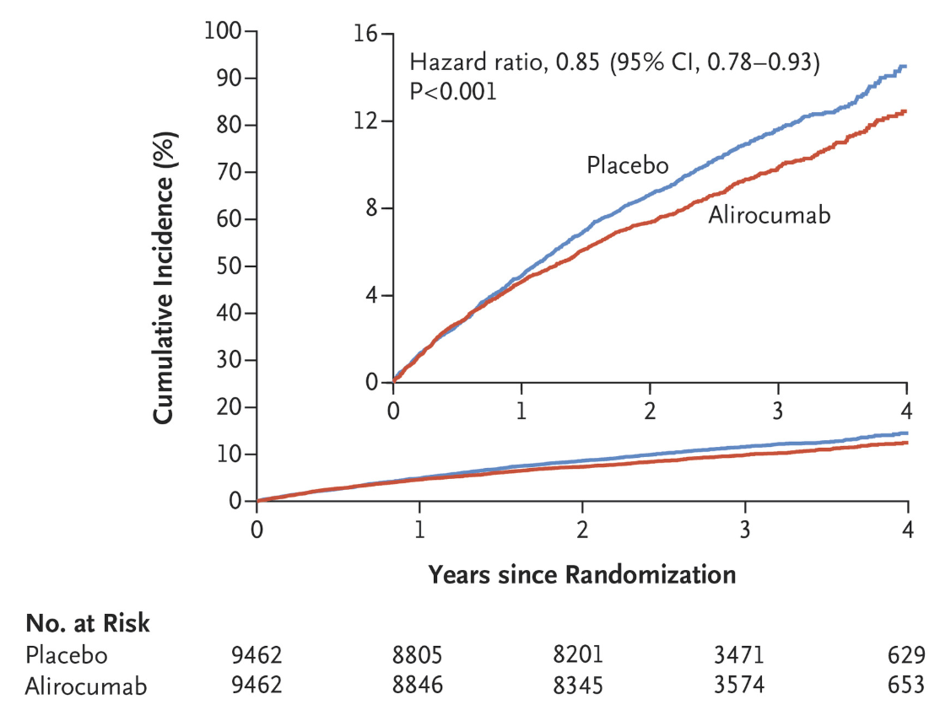
ODYSSEY OUTCOMES: Addition of PCSK9i to background statin therapy further reduces MACE
Study design¹
Primary efficacy endpoint^{2a}
Patients with ACS*
High-intensity or maximum-tolerated dose of atorvastatin or rosuvastatin
At least one lipid entry criterion met:
LDL-C ≥70 mg/dL
Non−HDL-C ≥100 mg/dL
Apolipoprotein B ≥80 mg/dL
Double-blind randomisation
1−12 months after ACS
N=18,924
Years since randomisation
Alirocumab
SC Q2W**
(n=9462)
Placebo SC Q2W
(n=9462)
Median follow-up 2.8 years (potential follow-up ~2–5 years);
ascertainment complete for >99% of potential patient-years of follow-up
for CV events and death
Safety: Incidence of adverse events and laboratory abnormalities was similar in the alirocumab group and the placebo group, apart from local injection site reaction (3.8% in alirocumab group versus 2.1% in the placebo group, p<0.001)
*1–12 months from index ACS event
**Blinded adjustment of alirocumab dose to target achieved LDL-C 25−50 mg/dL and avoid sustained levels <15 mg/dL.
ªPrimary efficacy end point (a composite of death from CHD, nonfatal MI, fatal or nonfatal ischaemic stroke, or unstable angina requiring hospitalisation). ACS, acute coronary syndrome.
1. Schwartz GG, et al. Am Heart J. 2014;168:682-689.e1; 2. Schwartz GG, et al. N Engl J Med. 2018;379:2097–107.

Slide 11
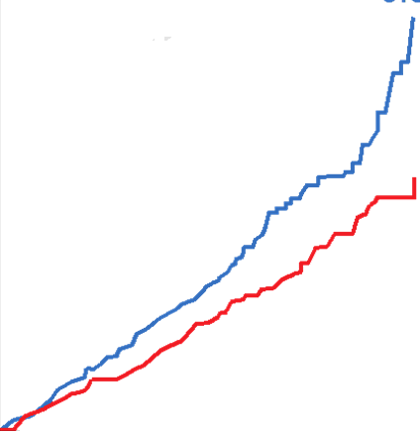
ODYSSEY OUTCOMES: All-cause death results
All patients (N=18,924)
Eligible for ≥3 years follow-up (N=8242)
≥100mg/dL
10
HR 0.71 (95% CI: 0.56–0.90)
HR 0.85 (95% CI: 0.73–0.98); p=0.03*
HR 0.78 (95% CI: 0.65–0.94); p=0.01*
8
ARR** 3.8%
6
Placebo
All-cause death (%)
All-cause death (%)
4
Alirocumab
2
0
0
1
2
3
4
Years since randomisation
Years since randomisation
Years since randomisation
2815
2814
2732
2739
2645
2655
1147
1186
224
240
(Post-hoc analysis)
*Nominal p-value due to hierarchical position of all-cause death among secondary endpoints. **Absolute risk reduction: interaction p=0.005, based on cumulative incidence across three baseline LDL-C subgroups (<80 mg/dL, 80–100 mg/dL, >100 mg/dL) at 4 years.
Steg GP, et al. Circulation. 2019;140:103–12.

Slide 12
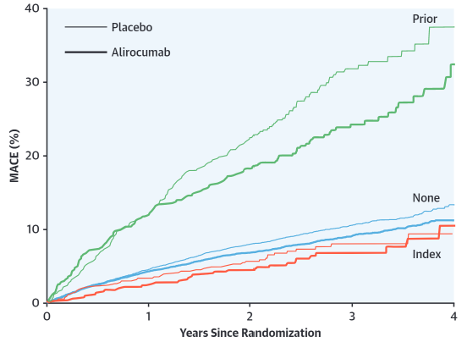
ODYSSEY OUTCOMES: Patients with higher baseline CV risk had greater absolute benefit from alirocumab
Baseline LDL-C ≥100 mg/dL
(≥2.59 mmol/L)
(ITT population)¹
Polyvascular disease^{c2}
CABG^{d3}
Placebo
20
16
Alirocumab
ARR 6.4 (95% CI 0.9, 12.0)
ARR 1.3 (95% CI 0.5, 2.2)
ARR 0.9 (95% CI -2.3, 4.0)
12
MACE (%)
ARR^{ab} 3.4%
8
HR 0.76
(95% CI: 0.65–0.87)
4
0
0
1
2
3
4
Number at risk
Years since randomisation
No CABG
Index CABGª
Prior CABG^{b}
16,896
1,025
1,003
15,790
985
877
14,815
947
783
6,354
348
343
1,142
64
76
Number at risk
Placebo
2,815
2,568
2,371
986
178
Alirocumab
2,602
2,431
1,053
207
2,814
ªBased on cumulative incidence; ^{b}p-interaction value for ARR <0.001 in post-hoc analysis; ^{c}Kaplan–Meier curves for primary MACE endpoint in patients with arterial disease in one (CAD and no PAD or CEVD), two (CAD and PAD or CEVD) and three (CAD and PAD and CEVD) vascular beds observed cumulative incidence of events over a median of 2.8 years. ^{d}Index CABG = CABG performed after the index ACS but before randomisation; prior CABG = CABG performed prior to the index ACS event. CABG, coronary artery bypass graft; CEVD, cerebrovascular disease; ITT, intent-to-treat.
1. Schwartz GG, et al. NEJM. 2018;379:2097–107; 2. Jukema JW, et al. J Am Coll Cardiol. 2019;74:1167–76; 3. Goodman SG, et al. J Am Coll Cardiol. 2019;74:1177–86.

Slide 13
ODYSSEY OUTCOMES analysis: Patients with higher CV risk gain significant benefit from alirocumab
Risk factor | MACE incidence (%) |  | HR (95% CI) | MACE ARR at median FU (2.8 years) | P-value | Size of subgroup
 | Alirocumab | Placebo
ACS (ITT study population)¹ | 9.5 | 11.1 | 0.85 (0.78–0.93) | 1.6% | <0.001 | 18,924 (100%)
Baseline LDL-C ≥100 mg/dL (2.6 mmol/L)¹ | 11.5 | 14.9 | 0.76 (0.65–0.87) | 3.4% | <0.001† | 5,629 (30%)
Diabetes² | 14.1 | 16.4 | 0.84 (0.74–0.97) | 2.3% | 0.0019† | 5,444 (29%)
Prior polyvascular disease in 3 beds³ | 26.8 | 39.7 | 0.64 (0.35–1.12) | 13.0% | 0.0006† | 149 (0.8%)
Lp(a) ≥59.6 mg/dL⁴ | 11.2 | 13.2 | Not available | 2.1% | 0.0011† | 4,734 (25%)
Prior CABG⁵ | 24.5 | 30.9 | 0.77 (0.61–0.98) | 6.4% | 0.0007† | 1,033 (5%)
†ARR interaction P value.
1. Schwartz GG, et al. N Engl J Med. 2018;379:2097–107; 2 Ray KK, et al. Lancet Diabetes Endocrinol. 2019;19(30):158-5; 3. Jukema JW, et al. JACC. 2019;74(9):1167–76; 4 Bittner VA, et al. Oral presentation at the American College of Cardiology, March 18, 2019; 5. Goodman SG et al. JACC 2020;75(4).

Slide 14
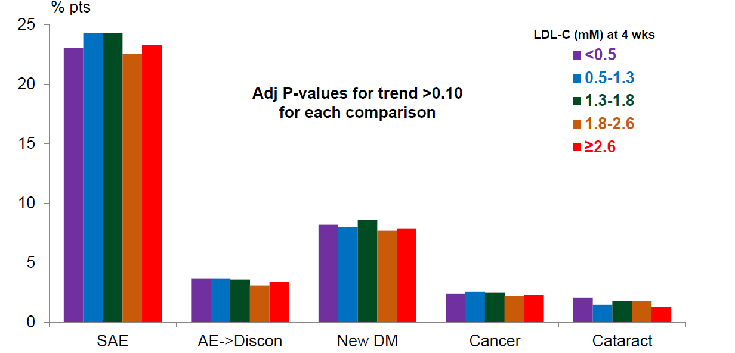
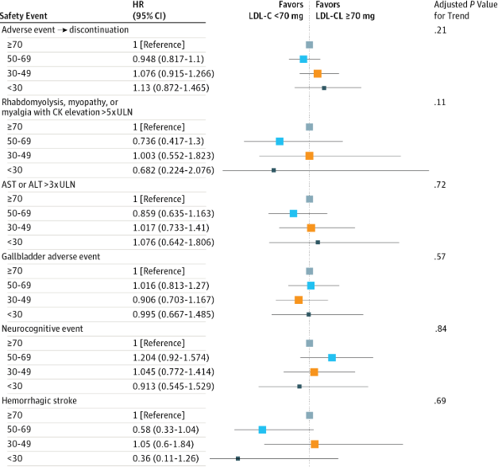
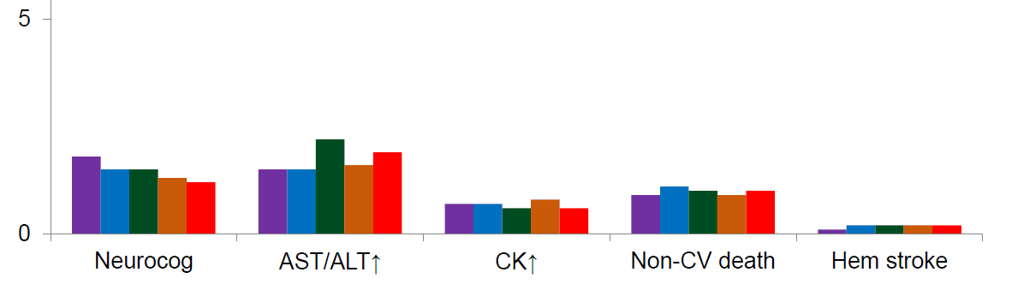
IMPROVE-IT and FOURIER: Safety of very low levels of LDL-C
IMPROVE-IT¹
FOURIER²
No offsetting adverse events or toxic effects were observed event in the range of low LDL-C levels in this trial
There was no association of very low LDL-C on evolocumab with neurocognitive events or haemorrhagic stroke
AE, adverse event; ALT, amino alanine transferase, AST, aspartate amino transferase; CK, creatine kinase; DM, diabetes mellitus; SAE, serious adverse event.
1. Giugliano RP, et al. JAMA Cardiol. 2017;2(5):547–55; 2. Giugliano RP, et al. Lancet. 2017;390(10106):1962‒71.

Slide 15
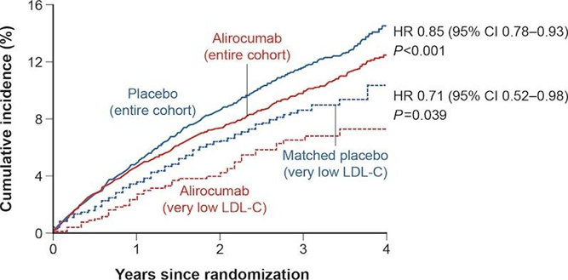
ODYSSEY OUTCOMES: Cumulative incidence of MACE and safety in patients with very low (consecutively <0.39 mmol/L [15 mg/dL]) LDL-C levels*
Cumulative incidence of MACE (%)
Despite blinded substitution of placebo for alirocumab, patients with very low achieved LDL-C on alirocumab had reduced MACE compared with PSM patients from the placebo group
These patients did not diminish overall efficacy
of alirocumab in ODYSSEY OUTCOMES
Very low LDL-C on alirocumab was not associated with risk of new-onset diabetes, compared with matched patients from the placebo group (15.1% vs 13.0%; HR 1.10, 95% CI: 0.85–1.43; p=0.46)
There was no association of very low LDL-C on alirocumab with neurocognitive events or haemorrhagic stroke
*Pre-specified analysis
Predefined safety: neurocognitive events; haemorrhagic stroke; new-onset diabetes in patients without diabetes at baseline (blindly adjudicated). Analysis evaluated efficacy and safety of very low achieved LDL-C (<15 mg/dL, median 9 mg/dL) with alirocumab (ALI, n=730, blinded substitution of placebo (PBO) at median of 8.3 months from randomisation using PSM to similar patients treated with PBO (n=2,152). Patients with consistently very low LDL-C levels (two measurements) were switched to placebo, therefore the long-term safety of more prolonged very low LDL-C, including risk of new-onset diabetes, deserves further study.
PSM, propensity score matching (to reduce confounding by post-randomisation LDL-C from differences in baseline characteristics).
Schwartz G, et al. Eur Heart J, Volume 40, Issue Supplement 1, October 2019, ehz748.0184.

Slide 16
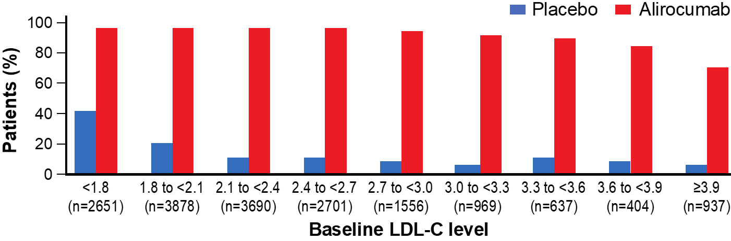
ODYSSEY OUTCOMES: Achievement of new LDL-C goals on PCSK9i + MTD statin therapy
In patients with a recent ACS and residual LDL-C elevation, despite intensive or maximum-tolerated statin therapy, adding alirocumab allowed 94.6% to reach the new 2019 European guideline target of LDL-C <1.4 mmol/L,
and 84.0% to reach the target of <1.0 mmol/L compared with 17.3% in the placebo arm (figure)
In contrast, the addition of ezetimibe prior to treatment would be expected to achieve LDL-C <1.4 mmol/L in
10% of patients at baseline, assuming an 18% reduction of LDL-C*
Percentage of patients who achieved LDL-C <1.4 mmol/L on at least one post-baseline measurement according to baseline LDL-C level
(Post-hoc analysis)
*18% is the mean LDL-C reduction outlined in the approved label for ezetimibe. Analysis performed using data from ODYSSEY OUTCOMES to evaluate how many patients reached LDL-C targets defined in ESC/EAS 2019 guidelines. MTD, maximum-tolerated dose.
Landmesser U, et al. Poster Presentation at the American College of Cardiology, March 28–30, 2020. Poster number: 1313-08.

Slide 17
SUMMARY
  The evolution of the EAS/ESC guidelines and new CVOTs bring new evidence for LDL-C treatment in very high-risk patients
  Based on new evidence:
    The lower (LDL-C), the better
    The greater (LDL-C) absolute reduction, the better
    The longer (LDL-C reduction), the better
  Contemporary management of very high-risk patients will often require combination therapy with statins, ezetimibe and PCSK9i to reach the EAS/ESC guideline targets
CVOT, cardiovascular outcome trial; EAS, European Atherosclerosis Society.

