Slide 1
Managing patients with dyslipidaemia
How to tackle
clinical inertia

Slide 2
This recorded INDUSTRY q&a SESSION specifically intended for healthcare professionals (HCPs) is sponsored by Sanofi on the occasion of ESC Congress 2020 – The Digital Experience, Saturday 29 August–Tuesday 01 September 2020. Individual medicinal products that may be referred to during this INDUSTRY SESSION may not be authorised/licensed in all countries. Content has been developed, where applicable, consistent with the EU Summary of Product Characteristics (SmPC). Please consult prescribing information in your country of practice current to date of viewing this content, in respect to medicinal products mentioned as information may vary from country to country.

Slide 3
How do the guidelines translate into clinical practice?
Prof Luís Masana (Spain)

Slide 4
DISCLOSURES
Professor Masana has received fees for lectures or advisory work from​ Amarin, Amgen, Amryt, Mylan, MSD, Novartis, Sanofi-Regeneron, Servier.

Slide 5
CONCEPT 1:
LDL-cholesterol is a causal factor
for atherosclerosis

Slide 6
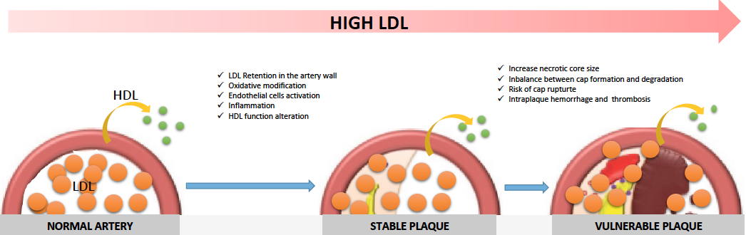
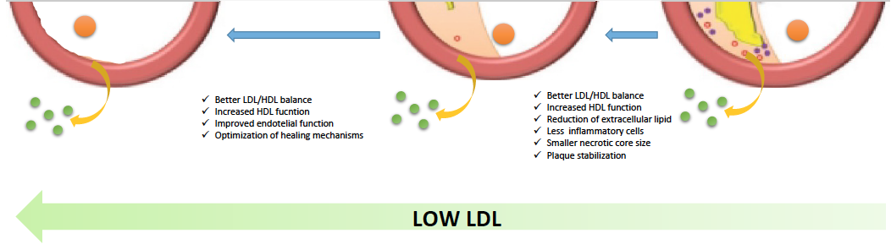
ESC, European Society of Cardiology; HCP, healthcare professional;
HDL, high-density lipoprotein; LDL, low-density lipoprotein. Adapted from: Boren J, et al. Eur Heart J. 2020 [Epub ahead of print].
This Industry Q&A Session was supported by Sanofi for the
ESC Congress 2020—The Digital Experience and is strictly for HCPs.
MAT-GLB-2000863 | July 2020

Slide 7
CONCEPT 2:
Even extremely low LDL-cholesterol levels are associated with incremental CV benefit with no additional side effects

Slide 8
LDL-C concentrations obtained in the main lipid-lowering randomized controlled trials¹*
LDL-C concentration achieved (mg/dL)
²
Publication year 1984 1994 2004 2005 2008 2014 2017 2018
*The table and graphs do not represent head-to-head comparisons, or indirect treatment comparisons; and trials
presented are conducted in different populations, and are not necessarily comparable
LDL-C, low-density lipoprotein cholesterol.
1. Adapted from: Masana L, et al. J Clin Lipidiol. 2018;12:292–99; 2. Schwartz GG, et al. N Engl J Med 2018;379:2097–107.

Slide 9
CONCEPT 3:
Cardiovascular risk reduction is driven
by LDL-cholesterol lowering,
regardless of lipid-lowering drug used

Slide 10
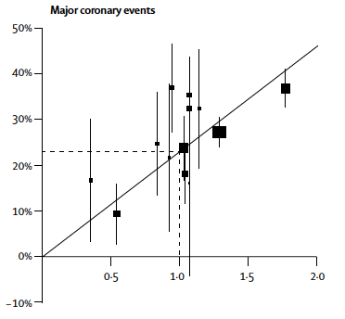
Cholesterol-lowering treatment: prospective meta-analysis of data from 90,056 participants in 14 randomised trials of statins (Cholesterol Treatment Trialists’ Collaboration)
Relation between proportional reduction in incidence of major coronary events and major vascular and mean absolute LDL-C reduction at 1 year¹
Proportional reduction in event rates (SE)
38.7 mg/dL of LDL-C reduction is associated with a 22% relative risk reduction²
Reduction in LDL-C (mmol/L)
SE, standard error.
1. Cholesterol Treatment Trialists’ (CTT) Collaboration. Lancet. 2005;366:1267–78;
2. Cholesterol Treatment Trialists’ (CTT) Collaboration. Lancet. 2010;376;1670–81.

Slide 11
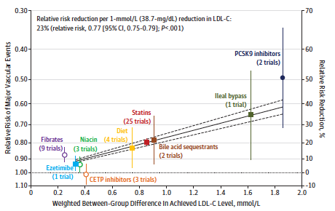
Relative risk reduction is driven by LDL-C lowering
CETP, cholesteryl ester transfer protein; CI, confidence interval; PCSK9, proprotein convertase subtilisin/kexin type 9.
Silverman MG, et al. JAMA. 2016;316(12):1289–97.

Slide 12
CONCEPT 4:
Attaining the new ESC/EAS 2019
LDL-cholesterol targets requires
high intensity lipid-lowering therapy

Slide 13
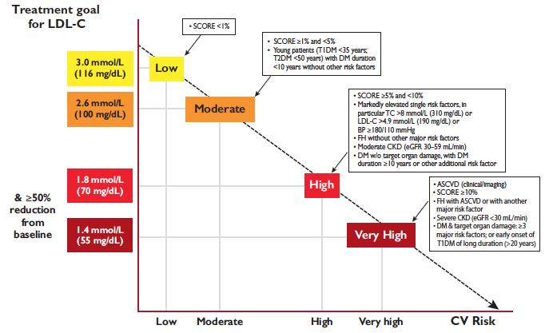
ESC/EAS 2019 guidelines: treatment goals for LDL-C across cardiovascular risk categories
1 mmol/L
(40 mg/dl)
Recurrent CVD
ASCVD, atherosclerotic cardiovascular disease; BP, blood pressure,
CKD, chronic kidney disease; CV, cardiovascular; CVD, cardiovascular disease;
DM, diabetes mellitus; EAS, European Atherosclerosis Society;
eGFR, estimated glomerular filtration rate; FH, familial hypercholesterolaemia;
SCORE, Systematic COronary Risk Evaluation; T1DM, type 1 diabetes mellitus;
T2DM, type 2 diabetes mellitus; TC, total cholesterol.
Mach F, et al. Eur Heart J. 2020;41:111–88.

Slide 14
And… at least a 50% REDUCTION!!!
Data for each treatment is collected from across multiple studies. The point estimate indicates the weighted average of pooled analysis, and the vertical bar shows the range of lipid-lowering effects of the included studies.
ATOR, atovastatin; FLUVA, fluvastatin; LOVA, lovastatin; PITA, pitavastatin; PRAVA, pravastatin; ROSU, rosuvastatin; SIMVA, simvastatin.
Adapted from: Catapano A, et al. Eur Heart J. 2016;37:2999–3058. Supplementary Figure A.

Slide 15
CONCEPT 5:
High-intensity
statins
Risk reduction is driven
by LDL-C lowering
LDL IS CAUSAL
High-intensity
lipid-lowering
therapy
Masana L, et al. Atherosclerosis. 2015;240:161–62.

Slide 16
Evidence-based combined lipid-lowering therapies*
High triglycerides
Statins
High cholesterol
Fibrates
Ezetimibe
Omega-3
PCSK9 inhibitors
Resins
*Thicker continuous lines indicate that at least one RCT supports the association. Thinner continuous lines indicate that combination is supported by subgroup analyses
RCT, randomised controlled trial.
Masana L, et al. Curr Card Rep. 2020;22(66).

Slide 17
Theoretical percentage LDL-C reduction produced by combined lipid therapies
Moderate-intensity statin
Moderate-intensity statin + EZE
Moderate-intensity statin + PCSK9i
High-intensity statin + PCSK9i
High-intensity statin
High-intensity statin + EZE
PCSK9i
EZE
-20 -40 -50 -60 -52 -60 -76 -80 -81 -84
Percentage LDL-C reduction
EZE, ezetimibe.
Figure created using data from Masana L, et al. Rev Esp Cardiol. 2016;69:342–3.
Masana L, et al. Curr Card Rep. 2020;22(66).

Slide 18
CONCEPT 6:
Therapeutic planning is crucial
to achieve the objectives

Slide 19



2019 ESC/EAS dyslipidaemia guidelines: Therapeutic strategy*
Highest tolerated statin dose
2 months
Ezetimibe
2 months
2 months
PCSK9i
*Prevention refers to ASCVD not MACE.
Mach F, et al. Eur Heart J. 2020;41:111–88.

Slide 20
2019 ESC/EAS dyslipidaemia guidelines: Therapeutic strategy*
Intensity of lipid-lowering treatment
Treatment
Average LDL-C reduction
Moderate-intensity statin ≈ 30%
High-intensity statin ≈ 50%
High-intensity statin plus ezetimibe ≈ 65%
PCSK9 inhibitor ≈ 60%
PCSK9 inhibitor plus high-intensity statin ≈ 75%
PCSK9 inhibitor plus high-intensity statin plus ezetimibe ≈ 85%
% reduction LDL-C
Baseline LDL-C
Absolute reduction LDL-C
Relative risk reduction
Baseline risk
Absolute risk reduction
*Theoretical LDL-C reduction
Mach F, et al. Eur Heart J. 2020;41:111–88; Masana L, et al. Rev Español Cardiol (English Ed). 2016;69:342–43.

Slide 21
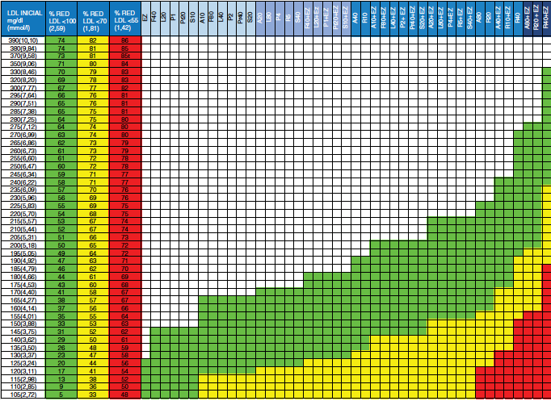
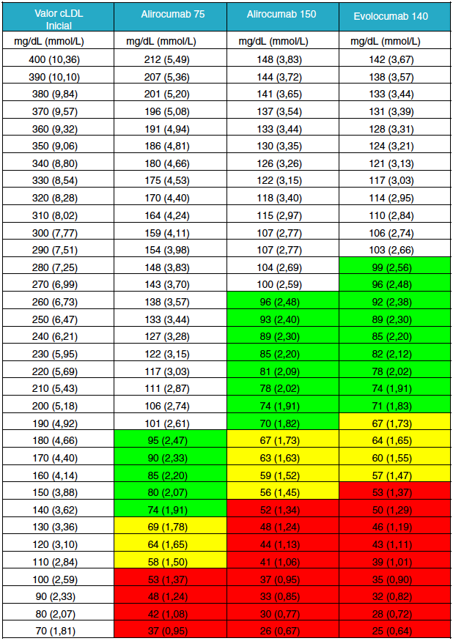
Tables to support decision-making*
*Theoretical LDL-C reduction
Masana L, et al. Clin Investig Arterioscler. 2019;31:271–7.

Slide 22
A comparison of two LDL-C targets after ischaemic stroke
2,860 patients after TIA and ischaemic stroke were enrolled and followed for a median of 3.5 years
Primary endpoint: ischaemic stroke, MI, urgent coronary or carotid revascularisation, or death from CV causes
MI, myocardial infarction; TIA, transient ischaemic attack.
Amarenco P, et al. NEJM. 2020;392:9–19.

Slide 23
Two out of five patients in the <70 mg/dL group were on combination therapy
Target: <70 mg/dL
Target: 90–110 mg/dL
STATIN + EZETIMIBE
HIGH INTENSITY
MODERATE INTENSITY
STATIN
LOW INTENSITY
Adapted from: Amarenco P, et al. NEJM. 2020;392:9–19. Supplementary material.

Slide 24
Take-home messages
LDL-C is a causal factor for atherosclerosis;
LDL-C lowering drives CV risk reduction
The number of patients achieving LDL-C targets is still unacceptably low
Planning therapy and personalised medicine could help in achievement of targets
Hospital protocols
Discharge summaries
Patients at high/very high CV risk should be put
on HIGH-INTENSITY LIPID-LOWERING THERAPY
Lipid-lowering combination therapy increases efficacy and adherence

