Slide 1

A Deep Dive into the
New 2019 ESC/EAS Guidelines
for the management of Dyslipidaemias:
lipid modification to reduce cardiovascular risk
PARTIE I: Aperçu des changements Majeurs
PARTIE II: De la théorie à l’exercice pratique: 6 cas patients
Task Force Members:
François Mach (ESC Chairperson) (Switzerland), Colin Baigent (ESC Chairperson) (United Kingdom), Alberico L. Catapano ( EAS Chairperson) (Italy), Konstantinos C. Koskinas (Switzerland), Manuela Casula¹ (Italy), Lina Badimon (Spain), M. John Chapman¹ (France), Guy G. De Backer (Belgium), Victoria Delgado (Netherlands), Brian A. Ference (United Kingdom), Ian M. Graham (Ireland), Alison Halliday (United Kingdom), Ulf Landmesser (Germany), Borislava Mihaylova (United Kingdom), Terje R. Pedersen (Norway), Gabriele Riccardi¹ (Italy), Dimitrios J. Richter (Greece), Marc S. Sabatine (United States of America), Marja-Riitta Taskinen¹ (Finland), Lale Tokgozoglu¹ (Turkey), Olov Wiklund¹ (Sweden).
¹Representing the European Atherosclerosis Society (EAS)
www.escardio.org/guidelines
2019 ESC/EAS Guidelines for the management of dyslipidaemias: lipid modification to reduce cardiovascular risk - Adapted from Mach F, et al. European Heart Journal 2019; 1-78
1

Slide 2
A Deep Dive into the
New 2019 ESC/EAS Guidelines
for the management of Dyslipidaemias:
lipid modification to reduce cardiovascular risk
PARTIE I:
Aperçu des changements Majeurs
www.escardio.org/guidelines
2019 ESC/EAS Guidelines for the management of dyslipidaemias: lipid modification to reduce cardiovascular risk - Adapted from Mach F, et al. European Heart Journal 2019; 1-78
1

Slide 3
DISCLOSURES
Disclosures

Slide 4
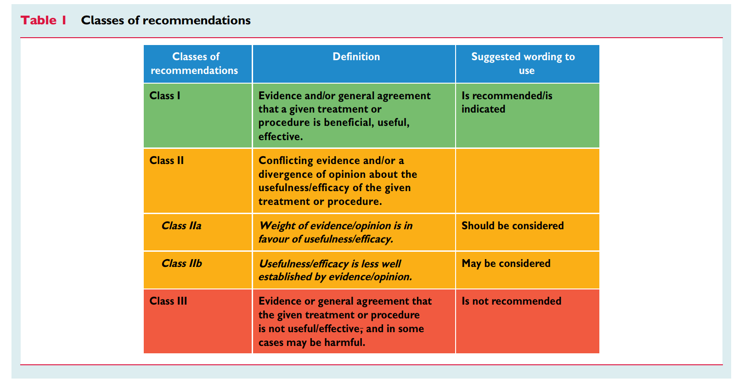
CLASSES OF RECOMMENDATIONS
Mach F, et al. Eur Heart J. 2019;0:1–78

Slide 5
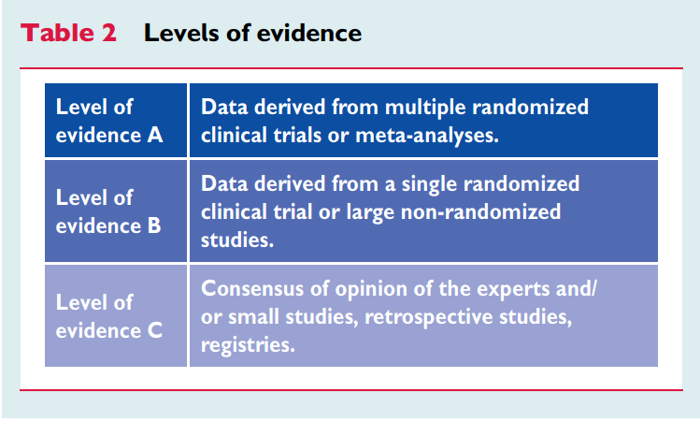
LEVELS OF EVIDENCE
Mach F, et al. Eur Heart J. 2019;0:1–78

Slide 6
DEEP DIVE INTO THE GUIDELINES
Risk categories
Risk assessment
Fundamental Principles for LDL-Lowering Therapy
Treatment Goals
Intervention strategies
Recommendations & treatment Algorithm for pharmacological LDL-C lowering
Algoritm for the treatment of muscular symptoms during statin treatment

Slide 7
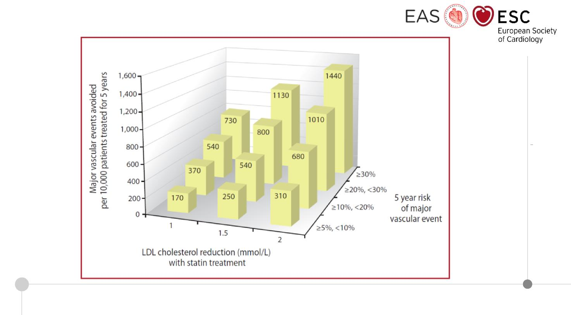
Absolute reductions in major vascular events with statin therapy
Mach F, et al. Eur Heart J. 2019; 0:1-78

Slide 8
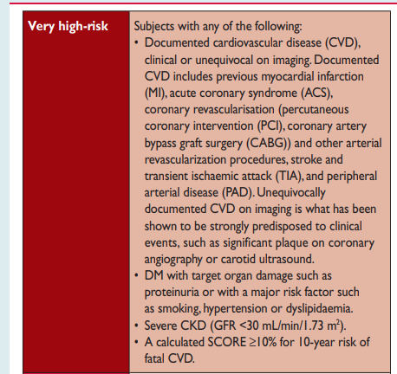
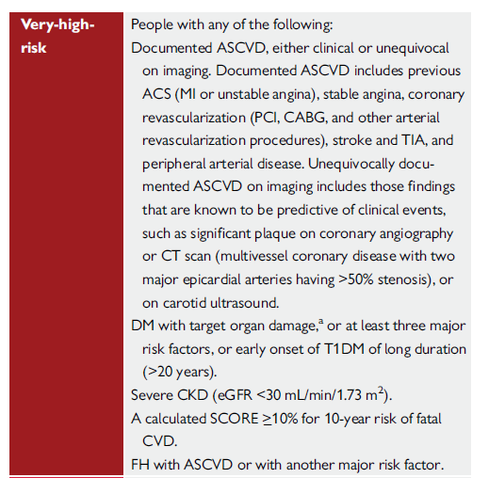
CARDIOVASCULAR RISK CATEGORIES
2016
2019
ASCVD definition more precise
DM definition more precise
  T1DM of long duration added
FH with ASCVD or another risk factor added
Catapano A, et al. Eur Heart J. 2016; 37, 2999-3058 - Mach F, et al. Eur Heart J. 2019; 0:1-78
Notes:
Patients with FH and ASCVD, or another major risk factor, are classified as very-high-risk, and those without known ASCVD and without other risk factors as high-risk. Recommended treatment goals are defined accordingly.

Slide 9
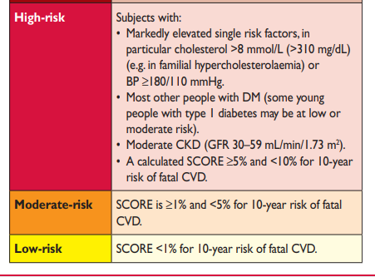
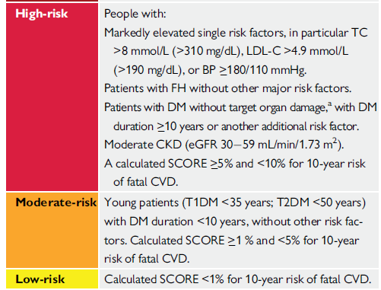
CARDIOVASCULAR RISK CATEGORIES
2016
2019
Mach F, et al. Eur Heart J. 2019; 0:1-78
Catapano A, et al. Eur Heart J. 2016; 37, 2999-3058

Slide 10
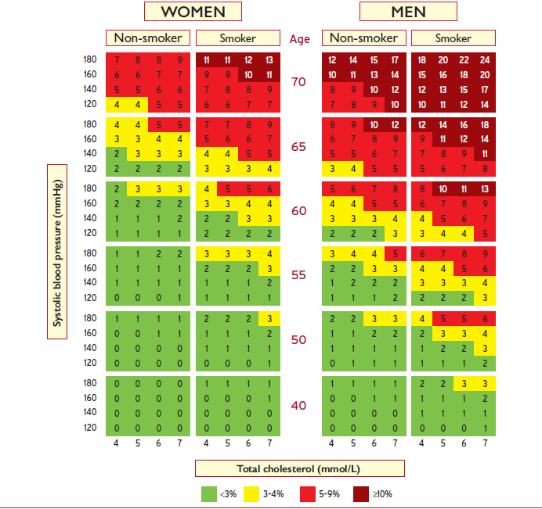
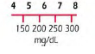
RISK ASSESSMENT : 10 year risk of fatal CVD
Low risk regions of Europe → age interactions included
The risk of this 40 year old male smoker with risk factors is the same (3-4%) as that of a 65 year-old man with ideal risk factor levels – therefore his risk age is 65 years
Mach F, et al. Eur Heart J. 2019; 0:1-78

Slide 11
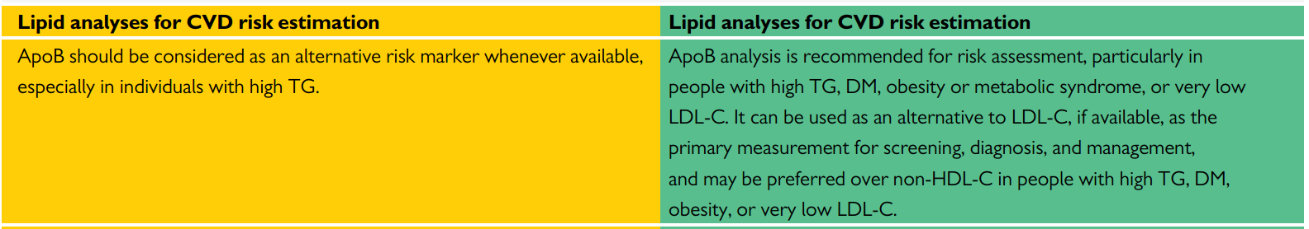
RISK ASSESSMENT - ApoB ANALYSIS
2016
2019
For CVD risk estimation
ApoB analysis NOW RECOMMENDED
(patients with high TG; DM; obesity or metabolic syndrome or very low LDL-C)
Mach F, et al. Eur Heart J. 2019; 0:1-78
Catapano A, et al. Eur Heart J. 2016; 37, 2999-3058

Slide 12
RISK ASSESSMENT - Imaging and Lp(a)
NEW
Cardiovascular imaging for assessment of ASCVD risk Assessment of arterial (carotid and/or femoral) plaque burden on arterial ultrasonography should be considered as a risk modifier in individuals at low or moderate risk.
Cardiovascular imaging for assessment of ASCVD risk CAC score assessment with CT should be considered as a risk modifier in the CV risk assessment of asymptomatic individuals at low or moderate risk.
Lipid analyses for CVD risk estimation Lp(a) measurement should be considered at least once in each adult person’s lifetime to identify those with very high inherited Lp(a) levels >180 mg/dL (>430 nmol/L) who may have a lifetime risk of ASCVD equivalent to the risk associated with heterozygous familial hypercholesterolaemia.
Mach F, et al. Eur Heart J. 2019; 0:1-78
Notes:
New recommendations

Slide 13
FUNDAMENTAL PRINCIPLES FOR LDL-LOWERING THERAPY
Trials of LDL-lowering indicate RELATIVE RISK reduction is proportional to the ABSOLUTE REDUCTION in LDL-C
Lower is better: lowering LDL-C with statins, ezetimibe, or PCSK9-inhibitors safe and effective to < 55 mg/dL (1.4 mmol/L )
Intensity of LDL-lowering therapy should be based on:
  (A) risk, irrespective of cause(s) of the risk (e.g., primary or secondary prevention, diabetes, or chronic kidney disease)
  AND
  (B) baseline LDL cholesterol (which determines how much reduction in risk can be achieved)
Mach F, et al. Eur Heart J. 2019; 0:1-78
Notes:
Absolute LDL-C reduction dictates RRR and defines ARR

Slide 14
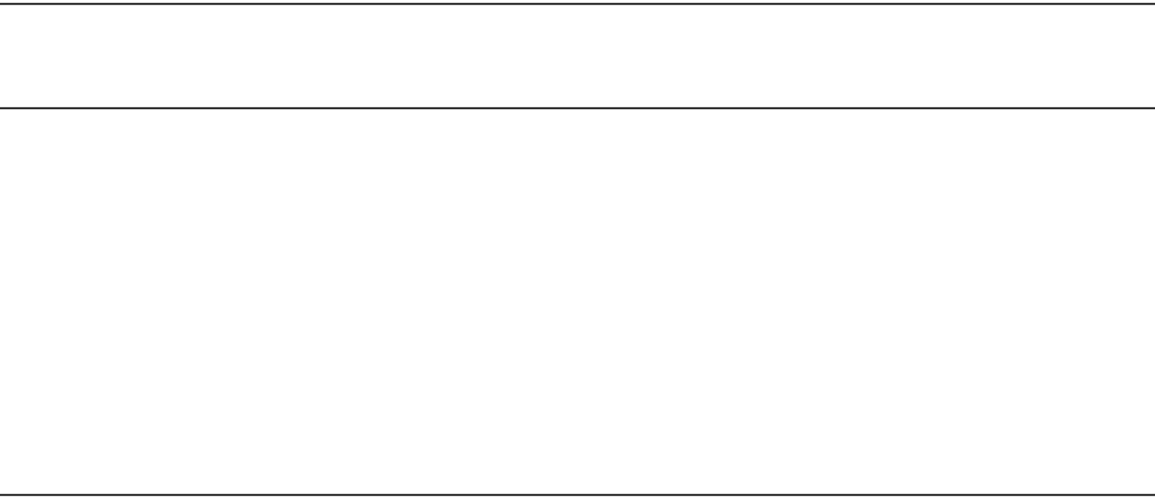
EVIDENCE FOR EFFICACY OF LDL-LOWERING THERAPIES
DOWN TO BELOW 1.4 mmol/L - 55 mg/dL
Source of evidence | Mean reduction in LDL cholesterol; mmol/L [mg/dL]
CTT meta-analysis¹ (high-intensity vs standard statin; subgroup <2.0 mmol/L) | 1.71 | [66] vs 1.32 | [50]
IMPROVE-IT² (eze plus statin vs statin) | 1.55 | [70] vs 1.40 | [54]
FOURIER³ (evolocumab plus high-dose statin ± eze vs high-dose statin ± eze) | 2.37 | [92] vs 0.78 | [30]
ODYSSEY OUTCOMES⁴ (alirocumab plus high-dose statin ± eze vs high-dose statin ± eze) | 2.37 | [92] vs 1.37 | [53]
Outcome RR (95% CI)
MI, CHD death,
stroke, coronary
revasc.
0.71 (0.56-0.91) [per mmol/L]
CV death, MI,
stroke, UA,
coronary revasc
0.94 (0.89-0.99)
CV death, MI,
stroke, UA,
coronary revasc
0.85 (0.79-0.92)
MI, CHD death, stroke, UA
0.85 (0.78-0.93)
^{1.}Lancet 2010; 376: 1670-81; ^{2.} NEJM 2015; 372: 2387-97; ^{3.} NEJM 2017; 376: 1713-22; ^{4.} NEJM 2018; 379: 2097-107
Mach F, et al. Eur Heart J. 2019; 0:1-78
Notes:
Back up documentation

Slide 15
RECOMMENDED TREATMENT GOALS FOR LDL-LOWERING THERAPY:
MAIN CHANGES FROM 2016 to 2019
Risk category
LDL goals (starting with untreated LDL-C)
2016 2019
Very-high-risk
High-risk
Moderate-risk Low-risk
1
B
<1.8 mmol/L (70 mg/dL)
or >50% if LDL-C 1.8-3.5
(70 - 135 mg/dL)
<2.6 mmol/L (100mg/dL)
or >50% if LDL-C 2.6-5.2
(100 - 200 mg/dL)
<3.0 mmol/L (115 mg/dL)
<3.0 mmol/L (115 mg/dL)
<1.4 mmol/L (55 mg/dL)
and > 50% ↓
<1.8 mmol/L (70 mg/dL)
and > 50% ↓
< 2.6 mmol/L (100 mg/dL)
< 3.0 mmol/L (116 mg/dL)
1
A
1
B
1
A
IIa
C
IIa
A
IIb
A
MORE INTENSIVE REDUCTION OF LDL-C ACROSS CV RISK CATEGORIES
Mach F, et al. Eur Heart J. 2019; 0:1-78
Catapano A, et al. Eur Heart J. 2016; 37, 2999-3058

Slide 16
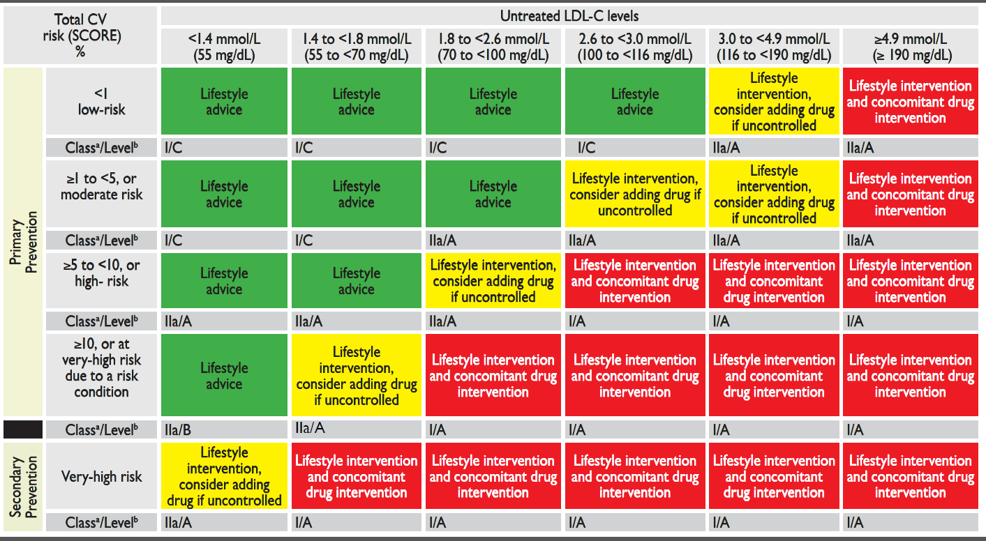
INTERVENTION STRATEGIES AS A FUNCTION OF TOTAL CARDIOVASCULAR RISK AND UNTREATED LOW-DENSITY LIPOPROTEIN CHOLESTEROL LEVELS (Table 5)
New category for secondary prevention without risk score
Mach F, et al. Eur Heart J. 2019; 0:1-78

Slide 17
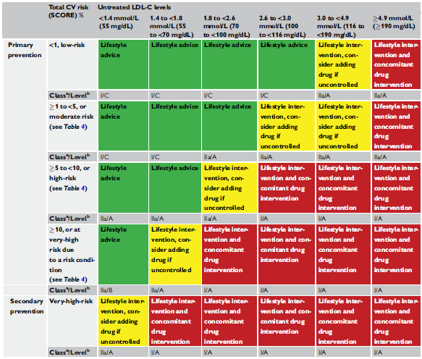
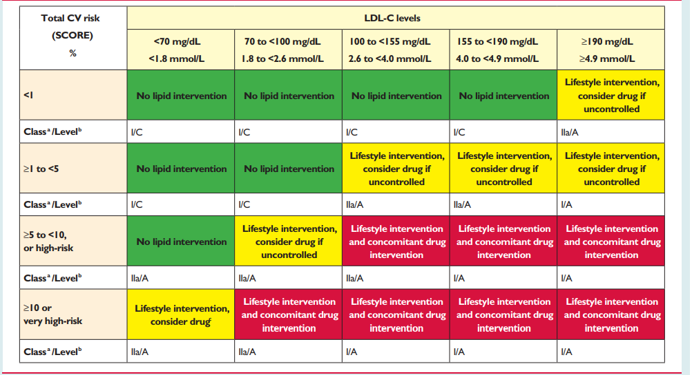
TABLE 5: 2016 vs 2019
2019
2016
Secondary prevention and primary prevention are well separated and well defined with specific emphasis on very high risk
Risk score not included for secondary prevention
LDL-C categories increased from 5 in 2016 to 6 in 2019 – ranging from 55 to 190 mg/dL - (1.4 to 4.9 mmol/L)
Catapano A, et al. Eur Heart J. 2016; 37, 2999-3058 - Mach F, et al. Eur Heart J. 2019; 0:1-78
Notes:
Secondary prevention and primary prevention are well separated and well defined with specific emphasis on very high risk
Risk score not included for secondary prevention
LDL-C categories changed (5 in 2016 and now 6 in 2019) – ranging from 55mg/dL to 190 mg/dL

Slide 18
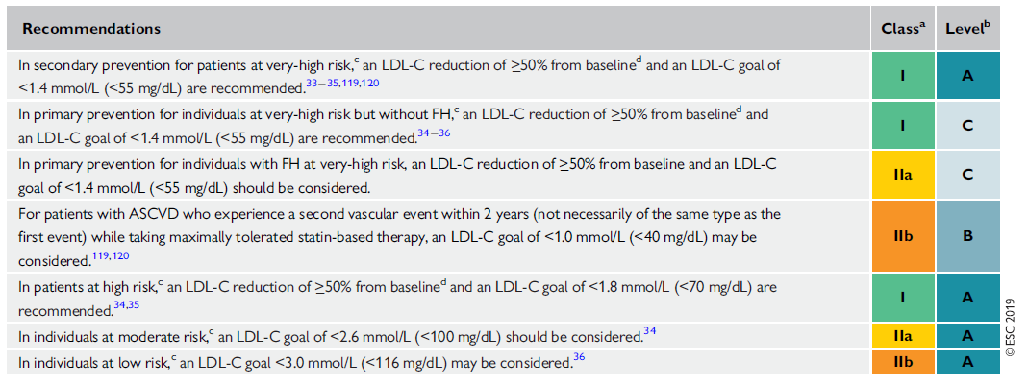
TREATMENT GOALS
New/Revised Concepts → Targets changed depending on CV risk :
Secondary prevention:
  ≥50% reduction AND target < 55mg/dL (1.4 mmol/L) (1A) & 40md/dL (< 1.0 mmol/L) ASCVD with second vascular event in 2 years on (IIb)
Primary prevention very high risk (w/o FH or w/o ASCVD):
  ≥50% reduction AND target < 55mg/dL (1.4 mmol/L) (1C)
Mach F, et al. Eur Heart J. 2019; 0:1-78

Slide 19
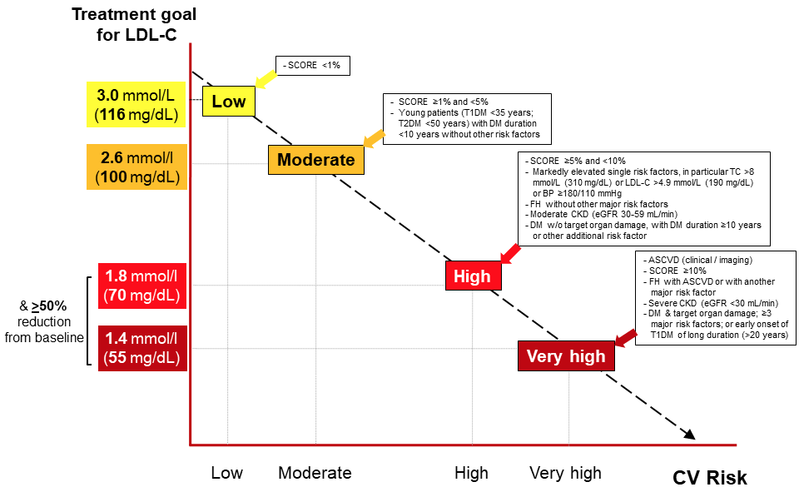
Treatment goals for low-density lipoprotein cholesterol (LDL-C) across categories of total cardiovascular disease risk
Mach F, et al. Eur Heart J. 2019; 0:1-78
Notes:
Summary slide

Slide 20
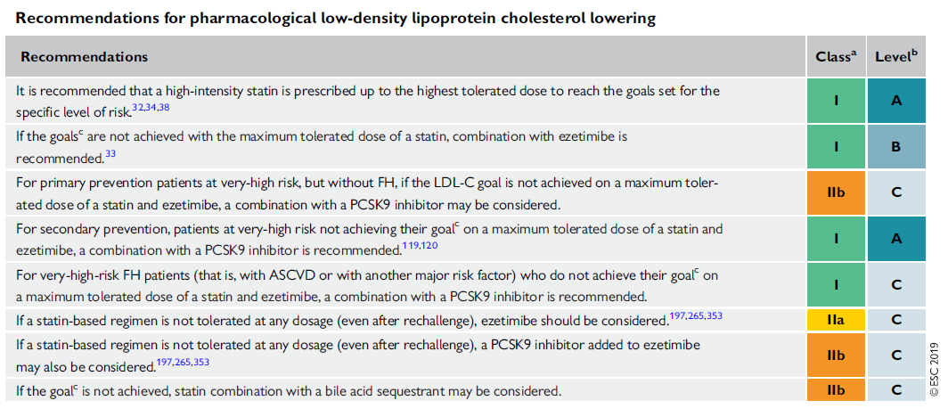
RECOMMENDATIONS FOR PHARMACOLOGICAL LDL-C LOWERING
Mach F, et al. Eur Heart J. 2019; 0:1-78
Notes:
Recommendations for pharmacological low-density lipoprotein cholesterol lowering

Slide 21
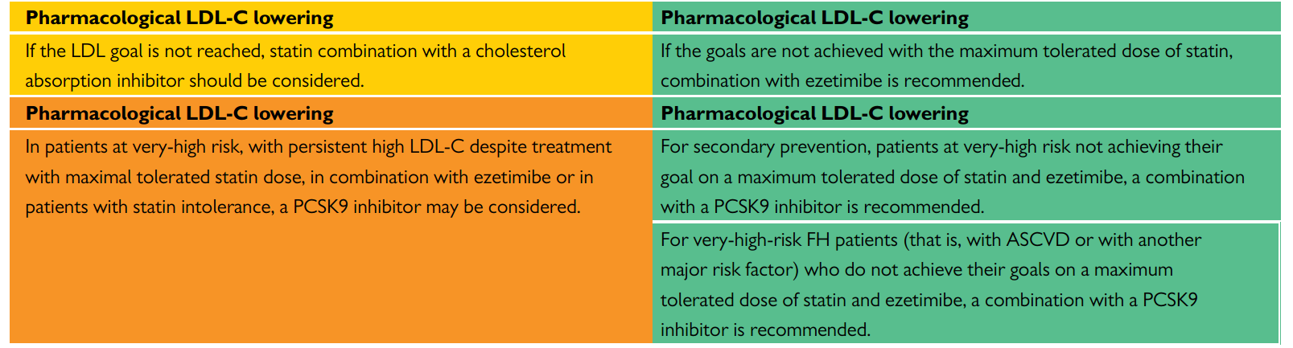
PHARMACOLOGICAL LDL-C LOWERING
2016
2019
Combination with ezetimibe is recommended
For secondary prevention (class IA) and very high risk FH (class IC);
PCSK9i RECOMMENDED
rather than may be considered.
2019 updated recommendations are based on the new outcome study data of PCSK9i.
Mach F, et al. Eur Heart J. 2019; 0:1-78 - Catapano A, et al. Eur Heart J. 2016; 37, 2999-3058
Notes:
PCSK9 recommended rather than may be considered for secondary prevention and very high risk FH.
New outcome study data of PCSK9 inhibitors are presented, and updated recommendations for their clinical use are provided.

Slide 22
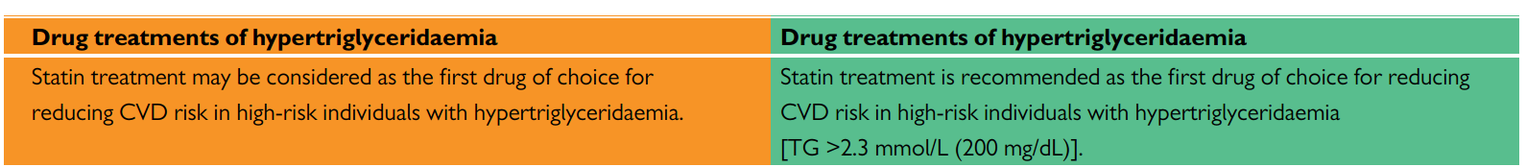
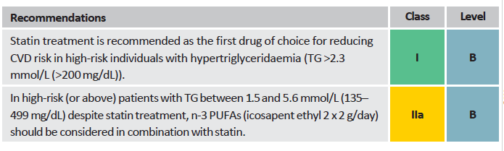
TREATMENT OF HYPERTRIGLYCERIDAEMIA
2016
2019
NEW
Mach F, et al. Eur Heart J. 2019; 0:1-78 - Catapano A, et al. Eur Heart J. 2016; 37, 2999-3058
Notes:
Icosapent ethyl, (Vascepa - 2x2 g/day), included based on REDUCE-IT trial

Slide 23
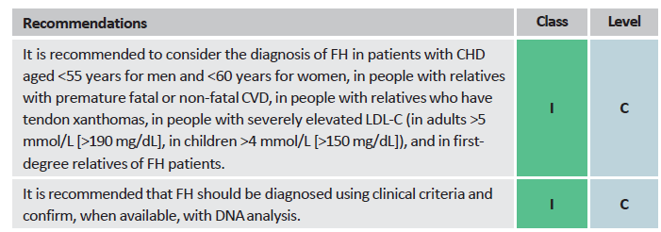
RECOMMENDATIONS FOR THE DETECTION AND TREATMENT OF PATIENTS WITH HETEROZYGOUS FAMILIAL HYPERCLOLESTEROLEMIA
Mach F, et al. Eur Heart J. 2019; 0:1-78

Slide 24
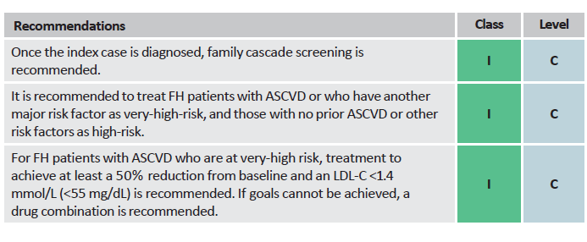
RECOMMENDATIONS FOR THE DETECTION AND TREATMENT OF PATIENTS WITH HETEROZYGOUS FAMILIAL HYPERCLOLESTEROLEMIA
Mach F, et al. Eur Heart J. 2019; 0:1-78

Slide 25
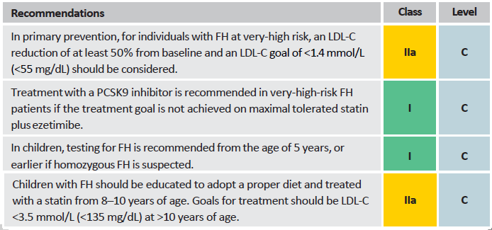
RECOMMENDATIONS FOR THE DETECTION AND TREATMENT OF PATIENTS WITH HETEROZYGOUS FAMILIAL HYPERCLOLESTEROLEMIA
NEW
Mach F, et al. Eur Heart J. 2019; 0:1-78

Slide 26
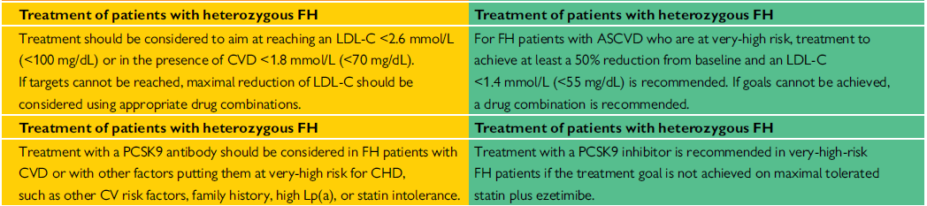
TREATMENT OF PATIENTS WITH HETEROZYGOUS FAMILIAL HYPERCHOLESTEROLEMIA
2016
2019
Therapy in HeFH pts
Class IIa-C to Class I-C
Targets decreased to < 55 mg/dL
Mach F, et al. Eur Heart J. 2019; 0:1-78 - Catapano A, et al. Eur Heart J. 2016; 37, 2999-3058
Notes:
New/revised concepts : Patients with FH and ASCVD, or another major risk factor, are classified as very-high-risk, and those without known ASCVD and without other risk factors as high-risk. Recommended treatment goals are defined accordingly.

Slide 27
RECOMMENDATIONS FOR LIPID-LOWERING THERAPY
IN VERY-HIGH-RISK PATIENTS WITH ACUTE CORONARY SYNDROME (ACS)
Recommendations
Class
Level
In all ACS patients without any contra-indication or definite history of intolerance, it is recommended to initiate or continue high dose statin as early as possible, regardless of initial LDL-C values.
I
A
Lipid levels should be re-evaluated 4–6 weeks after ACS to determine whether a reduction of at least 50% from baseline and goal levels of LDL-C <1.4 mmol/L (<55 mg/dL) have been achieved. Safety issues need to be assessed at this time and statin treatment doses adapted accordingly.
IIa
C
If the LDL-C goal is not achieved after 4–6 weeks with the maximally tolerated statin dose, combination with ezetimibe is recommended.
I
B
Mach F, et al. Eur Heart J. 2019; 0:1-78

Slide 28
RECOMMENDATIONS FOR LIPID-LOWERING THERAPY
IN VERY-HIGH-RISK PATIENTS WITH ACUTE CORONARY SYNDROME (ACS)
Recommendations
Class
Level
If the LDL-C goal is not achieved after 4–6 weeks despite maximal tolerated statin therapy and ezetimibe, adding a PCSK9 inhibitor is recommended.
I
B
In patients with confirmed statin intolerance or in patients in whom a statin is contra-indicated, ezetimibe should be considered.
IIa
C
For patients who present with an ACS and whose LDL-C levels are not at goal despite already taking a maximally tolerated statin dose and ezetimibe, adding a PCSK9 inhibitor early after the event (if possible, during hospitalization for the ACS event) should be considered.
IIa
C
Mach F, et al. Eur Heart J. 2019; 0:1-78

Slide 29
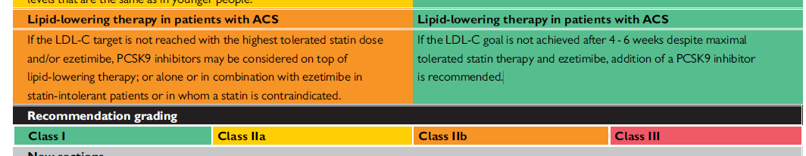
LIPID-LOWERING THERAPY IN PATIENTS WITH ACS
2016
2019
PCSK9i therapy in patients with ACS - class IIB to class IA
PCSK9i initiation in hospital should be considered for pts presenting with ACS already on MTD statin and ezetimibe – Class IIa
Mach F, et al. Eur Heart J. 2019; 0:1-78 –
Catapano A, et al. Eur Heart J. 2016; 37, 2999-3058

Slide 30
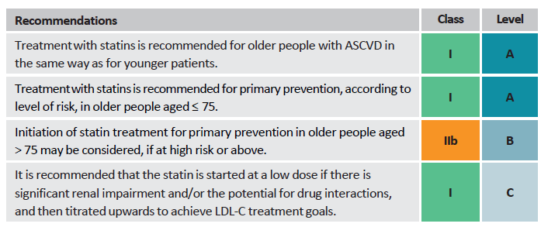
RECOMMENDATIONS FOR THE TREATMENT OD DYSLIPIDAEMIAS IN
OLDER PEOPLE AGED > 65 YEARS
NEW
Mach F, et al. Eur Heart J. 2019; 0:1-78

Slide 31
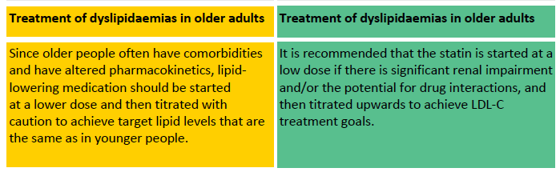
RECOMMENDATIONS FOR THE TREATMENT OF DYSLIPIDAEMIAS
IN OLDER ADULTS
2016
2019
Mach F, et al. Eur Heart J. 2019; 0:1-78
Catapano A, et al. Eur Heart J. 2016; 37, 2999-3058

Slide 32
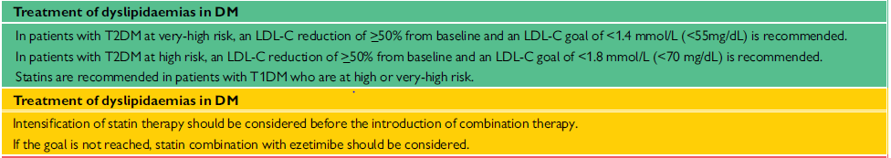
RECOMMENDATIONS FOR THE TREATMENT OF DYSLIPIDAEMIAS
IN DIABETES
NEW
Very high risk targets < 55 mg/dL
High risk target < 70 mg/dL
Mach F, et al. Eur Heart J. 2019; 0:1-78

Slide 33
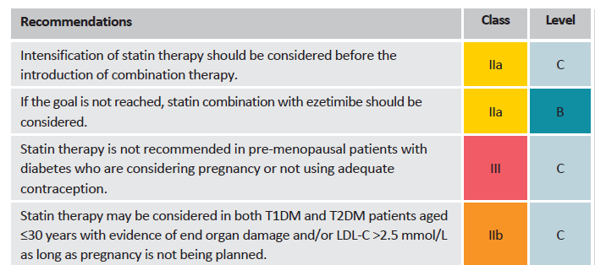
RECOMMENDATIONS FOR THE TREATMENT OF DYSLIPIDAEMIAS
IN DIABETES
NEW
Mach F, et al. Eur Heart J. 2019; 0:1-78

Slide 34
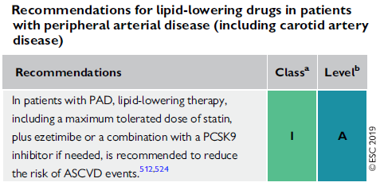
RECOMMENDATIONS FOR THE TREATMENT OF DYSLIPIDAEMIAS
WITH PAD
In patients with PAD,
a combination of LLT with a PCSK9i if needed,
Is RECOMMENDED
Mach F, et al. Eur Heart J. 2019; 0:1-78

Slide 35
TREATMENT ALGORITHM FOR PHARMACOLOGICAL LDL-C LOWERING
Total CV risk assessment
In selected low- and moderate-risk patients
Baseline LDL-C levels
Risk modifiers imaging (subclinical atherosclerosis) Risk Reclassification?
Indication for drug therapy?
Define treatment goal
Lifestyle advice/ Lifestyle intervention
High potency statin at highest
recommended/ tolerable dose to reach the goal
LDL-C goal reached?
New ESC/EAS 2019 Guidelines Acknowledge Statin/Ezetimibe as Step #2 Combination Therapy
Follow-up
Add ezetimibe
Annually, or more frequency
if indicated
LDL-C goal reached?
Secondary prevention (very-high-risk)
Primary prevention patients with FH and another major risk factor (very-high-risk)
Follow-up Annually, or more frequency
if indicated
Add PCSK9 inhibitor
Consider adding PCSK9 inhibitor
Primary prevention patients at very-high risk but without FH
Mach F, et al. Eur Heart J. 2019; 0:1-78
14

Slide 36
Expected clinical benefit of
LDL -C lowering therapies
Intensity of lipid-lowering treatment
Treatment
Moderate-intensity statin High-intensity statin
Average LDL-C reduction
≈ 30%
≈ 50%
High-intensity statin plus ezetimibe
≈ 65%
PCSK9 inhibitor
≈ 60%
PCSK9 inhibitor plus high-intensity statin
PCSK9 inhibitor plus high-intensity statin plus ezetimibe
≈ 75%
≈ 85%
% reduction LDL-C
Baseline LDL-C
Absolute reduction LDL-C
Relative risk reduction
Baseline risk
Absolute risk reduction
Mach F, et al. Eur Heart J. 2019; 0:1-78
LDL-C = low density lipoprotein cholesterol
PCSK9 = proprotein convertase subtilisin/kexin type 9

Slide 37
ALGORITHM FOR THE TREATMENT OF MUSCULAR SYMPTOMS
DURING STATIN TREATMENT
Consider if statin-attributed muscle symptoms favour statin continuation/reinitiation
Symptomatic & CK <4 X ULN CK ≥4 X ULN Rhabdomyolysis
2-4 weeks washout of statin
6 weeks washout of statin until normalisation of CK and symptoms
Symptoms persist:
Statin re-challenge
Check for other causes
of muscular symptoms
Symptoms improve: Second statin at usual or
starting dose
Low-dose third efficacious (potent) statin
Efficacious statin with alternate day or once/twice weekly dosing regimen
Symptoms re-occur
Low-dose third efficacious (potent) statin
Efficacious statin with alternate day or once/twice weekly dosing regimen
AIM: Achieve LDL-C goal with maximally tolerated dose of statin
Add a PCSK9 inhibitor
I/A recommendation for secondary prevention patients (very high risk)
I/C recommendation for primary prevention FH patients
with another major risk factor (very-high risk)
IIb/C recommendation for primary prevention in individuals at very high-risk but without FH)
Add ezetimibe
Consider adding bile acid sequestrant
IIb/C recommendation
Mach F, et al. Eur Heart J. 2019; 0:1-78
15
CK, creatine kinase; PCSK9, proprotein convertase subtilisin/kexin type 9; ULN, upper limit of normal

Slide 38
Treatment goals for low-density lipoprotein cholesterol (LDL-C) across categories of total cardiovascular disease risk
Mach F, et al. Eur Heart J. 2019; 0:1-78
Notes:
Summary slide

Slide 39
TAKE HOME MESSAGE
The new ESC/EAS 2019 dyslipidaemia guidelines propose, based on recent studies, a CV-risk-based approach and recommend new LDL-C goals, which are especially relevant to High- and Very-High-Risk patients
Based on new data, the recommendation for a stepwise approach has been strengthened
LDL-C management remains a key approach to reduce CVD events
More stringent LDL-C thresholds should be achieved in patients from Moderate to High to Very High CV risk (“the more CV risk goes up, the more LDL must come down”)
  The “treat to target” approach utilized in ODYSSEY OUTCOMES supports the new LDL-C goal:
    LDL-C goal of <1.4 mmol/L or <55 mg/dL for Very High Risk (VHR) patients (secondary and primary prevention)
    LDL-C goal of <1.0 mmol/L or <40 mg/dL for patients who experience a second vascular event within 2 years while taking maximally tolerated statin-based therapy

Slide 40
TAKE HOME MESSAGE
Intensification of LDL-lowering therapy should be pursued and based on:
  CV risk, irrespective of its underlying cause
  Baseline LDL-C
New Guidelines implementation in real life: a stepwise approach
  Use High-Intensity statin monotherapy for any specific level of CV risk
  Acknowledge statin-ezetimibe combination as step #2 if LDL goal is not achieved, based on:
strong expected clinical benefits (~65% LDL-C reduction)
high cost-effectiveness in reducing both LDL-C and CVD risk
  Add PCSK9-Inhibitors as step #3 if LDL goal still not achieved
PCSK9i are now officially recommended for clinical practice use in secondary prevention patients not at goal on MTD statin and ezetimibe, based on the strongest level of evidence possible (Class IA Recommendation)
Strong emphasis on the urgency to treat ACS patients (ODYSSEY OUTCOMES trial population) and the necessity to intensify lipid lowering treatment sooner after the ACS event including PCSK9i.

Slide 41
A Deep Dive into the
New 2019 ESC/EAS Guidelines
for the management of Dyslipidaemias:
lipid modification to reduce cardiovascular risk
PARTIE II:
De la théorie à l’exercice pratique
Développé en collaboration avec Prof. dr. G De Backer - UGent
www.escardio.org/guidelines
2019 ESC/EAS Guidelines for the management of dyslipidaemias: lipid modification to reduce cardiovascular risk - Adapted from Mach F, et al. European Heart Journal 2019; 1-78

Slide 42
Cas 1

Slide 43
Cas 1: Patient MW
Données patient
Démographie | 60 ans, femme, blanche, classe sociale inférieure
Raison de la consultation | fatique
Antécedents cliniques et familiaux | Inquiète de la mort subite de son frère à l’âge de 62 ans
Facteurs de risque CV | Jamais fumé ; physiquement inactive; 86 Kg, IMC 30 Kg/m²; tour de taille = 88 cm; PA: 120/76 mmHg
Profil lipidique | CT = 270 mg/dL, TGs = 250 mg/dL,
Laboratoire | Hémoglobine= 13,6 g/L
CV, cardiovasculaire; CT, cholestérol total; TG, triglyceride, PA, pression artérielle; IMC, Indice de masse corporelle

Slide 44
Question
Quel est son risque de développer une maladie CV fatale/10 ans?
Faible
Modéré
Élevé
Très élévé
Données patient
Démographie | 60 ans, femme, blanc, classe sociale inférieure
Raison de la consultation | fatique
Antécedents cliniques et familiaux | Inquiète de la mort subite de son frère à l’âge de 62 ans
Facteurs de risque CV | Jamais fumé ; physiquement inactive; 86 Kg, IMC 30 Kg/m²; tour de taille = 88 cm; PA: 120/76 mmHg
Profil lipidique | CT = 270 mg/dL, TGs = 250 mg/dL,
Laboratoire | Hémoglobine= 13,6 g/L

Slide 45
SCORE chart for European populations at low
cardiovascular disease risk
SCORE Cardiovascular Risk Chart
10-year risk of fatal CVD
Low-risk regions of Europe
Systolic blood pressure (mmHg)
WOMEN
MEN
Non-smoker
Smoker
Age
Non-smoker
Smoker
180 | 2 | 3 | 3 | 3 | 4 | 5 | 5 | 6
160 | 2 | 2 | 2 | 2 | 3 | 3 | 4 | 4
140 | 1 | 1 | 1 | 2 | 2 | 2 | 3 | 3
120 | 1 | 1 | 1 | 1 | 2 | 2 | 2 | 2
 | 4 | 5 | 6 | 7 | 4 | 5 | 6 | 7
5 | 6 | 7 | 8 | 8 | 10 | 11 | 13
4 | 4 | 5 | 5 | 6 | 7 | 8 | 9
3 | 3 | 3 | 4 | 4 | 5 | 6 | 7
2 | 2 | 2 | 3 | 3 | 4 | 4 | 5
4 | 5 | 6 | 7 | 4 | 5 | 6 | 7
60
Total cholesterol (mmol/L)
X 38,67 = mg/dL
 | <3% |  | 3-4% |  | 5-9% |  | ≥10%
45

Slide 46
Cas 1: Patient MW - Évaluation du risque CV total
Jamais fumé, PA: 120/76 mmHg, CT 270 mg/dL
Risque CV total:
- SCORE international 2003, pays à faible risque: 1%/10ans
- SCORE calibre pour la Belgique 2003 : 1%/10ans
- HeartScore avec HDL-C 56 mg/dL : 1%/10/ans
- SCORE international, pays à faible risque, 2019, interaction d’âge incluse: 1%/10ans

Slide 47
Question
Quel est son risque sur 10 ans d'une maladie CV mortelle?
Faible
Modéré
Élevé
Très élévé

Slide 48
Cas 1: Patient MW - Évaluation du risque CV total
Allez-vous
(a) Prescrire immédiatement une statine compte tenu du taux de cholestérol total de 270 mg/dL?
(b) Donner des conseils nutritionnels pour 6 mois puis la revoir?
(c) Vérifier d’autres aspects?

Slide 49
Recommendations for lipid analyses for
cardiovascular disease risk estimation (1)
Recommendations | Class | Level
TC is to be used for the estimation of total CV risk by means of the SCORE system. | I | C
HDL-C analysis is recommended to further refine risk estimation using the online SCORE system (www.Heartscore.org) | I | C
LDL-C analysis is recommended as the primary lipid analysis for screening, diagnosis and management. | I | C
TG analysis is recommended as a part of the routine lipid analysis. | I | C

Slide 50
Recommendations for lipid analyses for
cardiovascular disease risk estimation (2)
Recommendations | Class | Level
Non-HDL-C evaluation is recommended for risk assessment, particularly in people with high TG, diabetes, obesity or very low LDL-C. | I | C
ApoB analysis is recommended for risk assessment, particularly in people with high TG, diabetes, obesity or metabolic syndrome, or very low LDL-C. It can be used as an alternative to LDL-C, if available, as the primary measurement for screening, diagnosis and management, and may be preferred over non-HDL-C in people with high TG, diabetes, obesity or very low LDL-C. | I | C

Slide 51
Recommendations for lipid analyses for
cardiovascular disease risk estimation (3)
Recommendations | Class | Level
Lp(a) measurement should be considered at least once in each adult person’s lifetime to identify those with very high inherited Lp(a) levels >180 mg/dL (>430 nmol/L) who may have a lifetime risk of ASCVD equivalent to the risk associated with heterozygous familial hypercholesterolaemia. | IIa | C
Lp(a) should be considered in selected patients with a family history of premature CVD, and for reclassification in people who are borderline between moderate and high-risk. | IIa | C

Slide 52
Cas 1: Patient MW
Données patient
Démographie | 60 ans, femme, blanche, classe sociale inférieure
Raison de la consultation | fatique
Antécedents cliniques et familiaux | Inquiète de la mort subite de son frère à l’âge de 62 ans
Facteurs de risque CV | Jamais fumé ; physiquement inactive; 86 Kg, IMC 30 Kg/m²; tour de taille = 88 cm; PA: 120/76 mmHg
Profil lipidique | CT = 270 mg/dL, TGs = 250 mg/dL,
Laboratoire | Hémoglobine= 13,6 g/L
Profil lipidique complet disponible:
LDL-C = 164 mg/dL, HDL-C = 56 mg/dL, NON-HDL-C = 214 mg/dL, Lp(a) = 30 mg/dL
CV, cardiovasculaire; HDL-C, high-density lipoprotein cholesterol; LDL-C, low-density lipoprotein cholesterol; TG, triglyceride; Lp(a), lipoprotein a

Slide 53
Cas 1: Patient MW
Le taux de lipides sériques varient! Répéter un profil lipidique complet (condition de jeûne non nécessaire).
Elle est fatiguée et obèse. L’hypothyroïdie doit être exclue comme cause de la dyslipidémie.
Les femmes avec un seul facteur de risque CV sont mal représentées dans les essais cliniques.
Son risque CV total est évalué comme étant faible à modéré.
→ Il semble raisonnable de recommander en 1er lieu un changement des habitudes de vie avant de commencer un traitement sous statine.

Slide 54
Intervention strategies as a function of total cardiovascular risk and untreated low-density lipoprotein cholesterol levels

Slide 55
Total CV risk (SCORE)% | Untreated LDL-C levels
 | <1.4 mmol/L (55 mg/dL) | 1.4 to <1.8 mmol/L (55 to <70 mg/dL) | 1.8 to <2.6 mmol/L (70 to <100 mg/dL) | 2.6 to <3.0 mmol/L (100 to <116 mg/dL) | 3.0 to <4.9 mmol/L (116 to <190 mg/dL) | ≥4.9 mmol/L (≥190 mg/dL)
Primary Prevention
< 1 Low-risk | Lifestyle advice | Lifestyle advice | Lifestyle advice | Lifestyle advice | Lifestyle intervention, consider adding drug if uncontrolled | Lifestyle Intervention and concomitant drug intervention
Classª/Level^{b} | I/C | I/C | I/C | I/C | IIa/A | IIa/A
≥1 to <5, or moderate risk (see Table 1) | Lifestyle advice | Lifestyle advice | Lifestyle advice | Lifestyle intervention, consider adding drug if uncontrolled | Lifestyle intervention, consider adding drug if uncontrolled | Lifestyle Intervention and concomitant drug intervention
Classª/Level^{b} | I/C | I/C | IIa/A | IIa/A | IIa/A | IIa/A
©ESC

Slide 56
Cas 1: Conclusions
* Ajustement des habitudes de vie:
Nutrition: Une alimentation équilibrée pauvre en graisses saturées et riche en produits céréaliers, fruits, légumes et poissons.
Activité physique: 2.5 à 5 heures d’activités physiques modérément intenses par semaine ou 30 à 60 minutes par jour.
* Valeurs cibles : IMC 20–25 kg/m², tour de taille < 80 cm.
LDL-C : < 100 mg/dL
→ Si le LDL-C n’est pas sous contrôle avec des changements de style de vie, un traitement avec des statines peut être envisagé, en consultation avec le patient.

Slide 57
Cas 2

Slide 58
Cas 2: Patient SR
Données patient
Démographie | 46 ans, homme, blanc, travaille comme chauffeur de taxi à Bruxelles
Raison de la consultation | infection des voies respiratoires
Antécedents cliniques et familiaux | inconnu
Facteurs de risque CV | Fumeur 25 cigarettes/jour, hypertension, PA 160 mmg/Hg, IMC 31Kg/m², tour de taille = 118 cm
Profil lipidique | CT = 270 mg/dL, HDL-C = 39 mg/dL
Résultat | Poumons cliniquement libres; Le patient accepte de profiter de l'occasion pour estimer son risque CV total
CV, cardiovasculaire; CT, cholestérol total; TG, triglyceride, HDL-C, high-density lipoprotein cholesterol; PA, pression artérielle; IMC, Indice de masse corporelle

Slide 59
Question
Quel est son risque de développer une maladie CV fatale/10 ans?
Faible
Modéré
Élevé
Très élévé
Données patient
Démographie | 46 ans, homme, blanc, travaille comme chauffeur de taxi à Bruxelles
Raison de la consultation | infection des voies respiratoires
Antécedents cliniques et familiaux | inconnu
Facteurs de risque CV | Fumeur 25 cigarettes/jour, hypertension, PA 160 mmg/Hg, IMC 31Kg/m², tour de taille = 118 cm
Profil lipidique | CT = 270 mg/dL, HDL-C = 39 mg/dL
Résultat | Poumons cliniquement libres; Le patient accepte de profiter de l'occasion pour estimer son risque CV total

Slide 60
SCORE chart for European populations at low cardiovascular disease risk
SCORE Cardiovascular Risk Chart
10-year risk of fatal CVD
Low-risk regions of Europe
Systolic blood pressure (mmHg)
WOMEN
MEN
Non-smoker
Smoker
Age
Non-smoker
Smoker
180 | 0 | 0 | 0 | 0 | 1 | 1 | 1 | 1
160 | 0 | 0 | 0 | 0 | 0 | 0 | 0 | 1
140 | 0 | 0 | 0 | 0 | 0 | 0 | 0 | 0
120 | 0 | 0 | 0 | 0 | 0 | 0 | 0 | 0
 | 4 | 5 | 6 | 7 | 4 | 5 | 6 | 7
1 | 1 | 1 | 1 | 2 | 2 | 3 | 3
0 | 0 | 1 | 1 | 1 | 1 | 1 | 2
0 | 0 | 0 | 0 | 1 | 1 | 1 | 1
0 | 0 | 0 | 0 | 0 | 0 | 0 | 1
4 | 5 | 6 | 7 | 4 | 5 | 6 | 7
40
Total cholesterol (mmol/L) x 38,67 = mg/dL
 | <3% |  | 3-4% |  | 5-9% |  | ≥10%

Slide 61
Question
Quel est son risque de développer une maladie CV fatale/10 ans?
Faible
Modéré
Élevé
Très élévé
Risque selon le modèle SCORE 2019 – pays à faible risque : 1-2 %/10 ans
Serait-ce une sous-estimation?

Slide 62
Cas 2: Patient SR - Son risque CV total de 1 à 2% est-il une sous-estimation?
OUI parce que:
Il a 46 ans, pas 40 ans
Il a un CT de 270 mg/dL, pas 240
Il a un HDL-C de seulement 39 mg/dL
What next?
Tenir compte d’autres facteurs de risque

Slide 63
Cas 2 : Patient SR: Autres facteurs de risque?
La version électronique de SCORE, HeartScore, vous permet de saisir les chiffres exacts du cholesterol total, du PA et de l’âge, ainsi que du HDL-C.
Avec HeartScore, son risque n’est pas de 1% mais de 3% /10ans
www.Heartscore.org
D’autres facteurs de risque ?

Slide 64
Facteurs pouvant modifier le risque de SCORE
- Classe sociale
- Obésité et obésité centrale - Inactivité physique
- Stress psychosocial
- Antécédents familiaux de maladie CV prématurée (homme < 55 ans; femme < 60 ans)
- Maladie mentale grave
- Maladies inflammatoires chroniques à médiation immunitaire
- Traitement de l’infection à VIH
- Syndrome d'apnée obstructive du sommeil
- Autres paramètres lipidiques : Lp(a), HDL-C, TG,
Notes:
Referentie toevoegen

Slide 65
Facteurs pouvant modifier le risque de SCORE – Mr. SR
- Classe sociale OUI
- Obésité et obésité centrale OUI - Inactivité physique OUI
- Stress psychosocial NON
- Antécédents familiaux de maladie CV prématurée (homme < 55 ans; femme < 60 ans) OUI, son père est décédé suite à un IMA à l’âge de 49 ans
- Maladie mentale grave NON
- Maladies inflammatoires chroniques à médiation immunitaire NON
- Traitement de l’infection à VIH NON
- Syndrome d'apnée obstructive du sommeil NON
- Autres paramètres lipidiques : Lp(a), HDL-C, TG, OUI, HDL-C 39 mg/dL
Notes:
Referentie toevoegen

Slide 66
Compte tenu des résultats de HeartScore (3%/10 ans) et des autres facteurs de risque (classe sociale inférieure, obésité et obésité centrale, inactivité physique, faible HDL-C et antécédents familiaux positifs), son risque CV total est supérieur à 5%/10 ans.
Comment allons-nous le conseiller ensuite?
Cas 2: Patient SR

Slide 67
Carte de risque relatif
Cette carte peut être utilisée pour indiquer que le risque CV total d'une personne est considérablement augmenté. Cela peut aider à les motiver à changer leurs habitudes de vie et / ou à considérer le besoin de médicaments. Dans le cas de Mr SR. son risque relatif est 7 fois supérieur à celui d'un homme du même âge qui ne fume pas, a une SBD <140 mmHg et un CT <200 mg/dL .
X 38,67 = mg/dL

Slide 68
Âge selon le profil de risque
Définition:
„L'âge d'une personne présentant des facteurs de risque est comparé
avec celui d'une personne présentant un profil de risque idéal.
La personne avec les facteurs de risque a l'âge cardiovasculaire
de la personne avec un profil de risque idéal.”
Synonymes:
Âge cardiovasculaire

Slide 69
10-year risk of fatal CVD (1)
Low-risk regions of Europe (age interactions included)
WOMEN
MEN
 | Non-smoker |  |  |  | Smoker |  |  |  | Age | Non-smoker |  |  |  | Smoker
180 | 7 | 8 | 8 | 9 | 11 | 11 | 12 | 13 |  | 12 | 14 | 15 | 17 | 18 | 20 | 22 | 24
160 | 6 | 6 | 7 | 7 | 9 | 9 | 10 | 11 | 70 | 10 | 11 | 13 | 14 | 15 | 16 | 18 | 20
140 | 5 | 5 | 6 | 6 | 7 | 8 | 8 | 9 |  | 8 | 9 | 10 | 12 | 12 | 13 | 15 | 17
120 | 4 | 4 | 5 | 5 | 6 | 6 | 7 | 7 |  | 7 | 8 | 9 | 10 | 10 | 11 | 12 | 14
180 | 4 | 4 | 5 | 5 | 7 | 7 | 8 | 9 |  | 8 | 9 | 10 | 12 | 12 | 14 | 16 | 18
160 | 3 | 3 | 4 | 4 | 5 | 6 | 6 | 7 | 65 | 6 | 7 | 8 | 9 | 9 | 11 | 12 | 14
140 | 2 | 3 | 3 | 3 | 4 | 4 | 5 | 5 |  | 5 | 5 | 6 | 7 | 7 | 8 | 9 | 11
120 | 2 | 2 | 2 | 2 | 3 | 3 | 3 | 4 |  | 3 | 4 | 5 | 5 | 5 | 6 | 7 | 8
180 | 2 | 3 | 3 | 3 | 4 | 5 | 5 | 6 |  | 5 | 6 | 7 | 8 | 8 | 10 | 11 | 13
160 | 2 | 2 | 2 | 2 | 3 | 3 | 4 | 4 | 60 | 4 | 4 | 5 | 5 | 6 | 7 | 8 | 9
140 | 1 | 1 | 1 | 2 | 2 | 2 | 3 | 3 |  | 3 | 3 | 3 | 4 | 4 | 5 | 6 | 7
120 | 1 | 1 | 1 | 1 | 2 | 2 | 2 | 2 |  | 2 | 2 | 2 | 3 | 3 | 4 | 4 | 5
180 | 1 | 1 | 2 | 2 | 3 | 3 | 3 | 4 |  | 3 | 4 | 4 | 5 | 6 | 7 | 8 | 9
160 | 1 | 1 | 1 | 1 | 2 | 2 | 2 | 3 | 55 | 2 | 2 | 3 | 3 | 4 | 4 | 5 | 6
140 | 1 | 1 | 1 | 1 | 1 | 1 | 1 | 2 |  | 1 | 2 | 2 | 2 | 3 | 3 | 3 | 4
120 | 0 | 0 | 0 | 1 | 1 | 1 | 1 | 1 |  | 1 | 1 | 1 | 2 | 2 | 2 | 2 | 3
180 | 1 | 1 | 1 | 1 | 2 | 2 | 2 | 3 |  | 2 | 2 | 3 | 3 | 4 | 5 | 5 | 6
160 | 0 | 0 | 1 | 1 | 1 | 1 | 1 | 2 | 50 | 1 | 1 | 2 | 2 | 2 | 3 | 3 | 4
140 | 0 | 0 | 0 | 0 | 1 | 1 | 1 | 1 |  | 1 | 1 | 1 | 1 | 1 | 2 | 2 | 3
120 | 0 | 0 | 0 | 0 | 0 | 0 | 0 | 1 |  | 0 | 1 | 1 | 1 | 1 | 1 | 1 | 2
180 | 0 | 0 | 0 | 0 | 1 | 1 | 1 | 1 |  | 1 | 1 | 1 | 1 | 2 | 2 | 3 | 3
160 | 0 | 0 | 0 | 0 | 0 | 0 | 0 | 1 | 40 | 0 | 0 | 1 | 1 | 1 | 1 | 1 | 2
140 | 0 | 0 | 0 | 0 | 0 | 0 | 0 | 0 |  | 0 | 0 | 0 | 0 | 1 | 1 | 1 | 1
120 | 0 | 0 | 0 | 0 | 0 | 0 | 0 | 0 |  | 0 | 0 | 0 | 0 | 0 | 0 | 0 | 1
 | 4 | 5 | 6 | 7 | 4 | 5 | 6 | 7 |  | 4 | 5 | 6 | 7 | 4 | 5 | 6 | 7
Systolic blood pressure (mmHg)
Illustration of the risk age concept
Le risque de ce fumeur de 46 ans avec d'autres facteurs de risque est le même (2%) que celui d'un homme de 60 ans avec un profil de risque optimal - donc son âge cardiovasculaire est de 60 ans
 | <3% |  | 3-4% |  | 5-9% |  | ≥10%
Total cholesterol (mmol/L) x 38,67 = mg/dL
©ESC

Slide 70
Cas 2: Patient SR
Son risque relatif est au moins x7 et son âge cardiovasculaire est au moins de 60 ans au lieu de 46
Son risque CV absolu total est > 5% /10 ans selon HeartScore et d’autres facteurs de risque
Le risque relatif et l’âge cardiovasculaire sont utiles pour illustrer le risque mais pas pour prendre des decisions concernant le traitement.
En function de son risque CV absolu, vous pouvez proposer des changements de son mode de vie et envisager des medicaments antihypertenseurs et hypolipémiques.
Envisagez-vous:
- Un dépistage de l’athérosclérose subclinique?
- Des tests génétiques pour le HF?

Slide 71
Cas 2: Calcium CT ou tests génétiques?
Dépistage de l’athéroslérose subclinique peut être utile pour reclasser les personnes présentant un risque CV total modérément accru, mais pour Mr SR. cela n'est pas nécessaire puisque son risque CV total est déjà augmenté de toute façon, ce qui nécessite une action préventive intensive.
Les tests génétiques pour HF ne change probablement pas l’approche thérapeutique – mais, il est recommandé de déterminer « le profil de risque » notamment le profil lipidique de toutes les personnes relatives au premier degré de Mr SR. (cascade screening)

Slide 72
Cas 2: Conclusions
La prévention primaire des MCV doit être guidée par le risque CV total du patient. Mais son évaluation n'est pas une science exacte et reste risquée au niveau individuel. Il permet de diviser la population en groupes avec un profil de risque différent. HeartScore peut rendre l'estimation plus précise et d'autres facteurs de risque CV doivent également être pris en considération.
Le risque relatif et l'âge cardiovasculaire peuvent être utiles pour la communication mais ont peu de valeur dans les décisions concernant le traitement médicamenteux.
Les décisions concernant les traitements médicamenteux doivent être basées sur les résultats des études cliniques avec le risque absolu à la base.
Le dépistage de l'athérosclérose subclinique peut améliorer l'évaluation des risques chez les personnes présentant un profil de risque SCORE modérément augmenté, mais ne changera pas la politique chez les personnes présentant un risque SCORE accru.

Slide 73
Cas 3

Slide 74
Cas 3: Patient IG
Données patient
Démographie | 52 ans, homme
Antécedents cliniques et familiaux | NSTEMI il y a 6 mois
Facteurs de risque CV | Fumeur depuis 30 ans, hypertension, hypercholestérolémie (insuffisamment traitée)
Profil lipidique | LDL-C = 140 mg/dL, HDL-C = 50 mg/dL, TGs = 70 mg/dL
Traitement | Atorvastatine 80 mg/jour
Résultat | LDL-C = 70 mg/dL
Follow-up | Douleurs musculaires 3 mois après le début du traitement aux statines, CK 520 U/L (normal CK range: 22–198 U/L)
Quels sont les défis de ce cas?
Devriez-vous arrêter le traitement par l'atorvastatine?
Si oui, quel autre médicament hypolipidémiant prescririez-vous?
Si oui, quelle dose?
Comment augmenteriez-vous la dose?
Envisageriez-vous une thérapie combinée? Si oui, laquelle?
CK, creatine kinase; CV, cardiovasculaire; HDL-C, high-density lipoprotein cholesterol; LDL-C, low-density lipoprotein cholesterol; NSTEMI, non-ST segment elevation myocardial infarction; TG, triglyceride

Slide 75
Intolérance aux statines
De nombreux patients traités avec des statines n'atteignent pas les cibles LDL-C.
La cause principale d'intolérance aux statines est « les effets secondaires ».
Les effets secondaires:
- Sont généralement temporairement liées à l'utilisation de statines,
- s'améliorent lorsque la statine est arrêtée et
- reviennent dès la reprise de statines
L'intolérance aux statines n'est pas rare, avec une fréquence de près de 10-20% (selon certains auteurs)
Pour qui?
- Plus de patients sont éligibles à la statine
- Utilisation accrue de fortes doses de statines
LDL-C, low density lipoprotein
Reiner Ž. Nutr Metab Cardiovasc Dis. 2014;24:1057–66

Slide 76
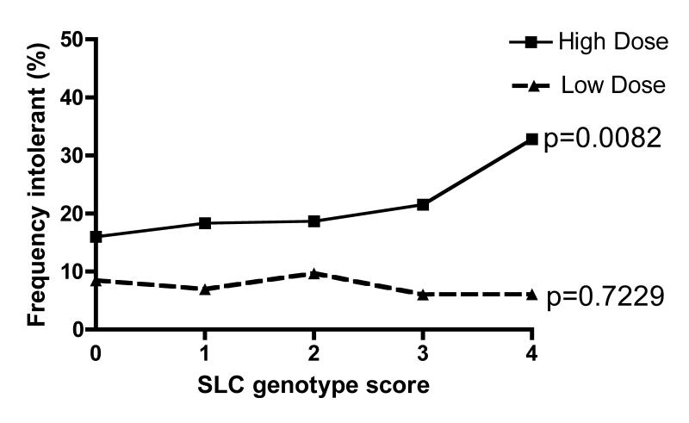
Fréquence d'intolérance dans l'ensemble de la population stratifiée par dose
p-values shown are for Chi squared tests for trend (1df.) across the SLCO1B1 genotype score
Donnelly LA, et al. Clin Pharmacol Ther. 2011;89(2):210–6

Slide 77

Statines: effets secondaires
Myopathie: tout type de maladie musculaire^{1–3}
  Myalgie: douleur dans un muscle ou un groupe musculaire
    ~10%
  Myosite: symptoms musculaires avec ↑ CK
    ~2.5%
  Rhabdomyolyse: >50 fois ↑ dans CK + insuffisance rénale
    <0.1%
Augmentation de l’AST et ALT⁴
  <3x ULN: ~1.3%
  >3x ULN: <1.0%
    Lié à la dose
REMARQUE: Consultez le SmPC pour la liste complète des effets secondaires liés aux statines. Seuls les 2 effets indésirables les plus spécifiques des statines sont cités ici
1. Bruckert E, et al. Cardiov Drugs. 2005;19:403;
2. Brown WV. Curr Opin Lipid. 2008;19:558; 3. Šimić I and Reiner Ž. Curr Pharm Des. 2015;21:1220–6; 4. Onusko E.
J Fam Pract. 2008;57:449
ALT, alanine aminotransferase; AST, aspartate aminotransferase; CK, creatine kinase; ULN, upper limit of normal

Slide 78
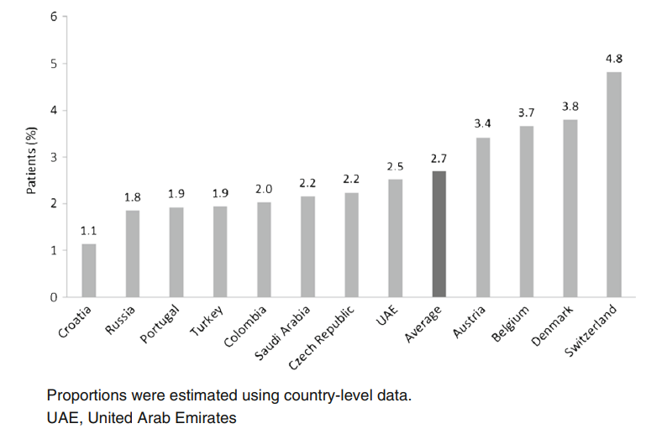
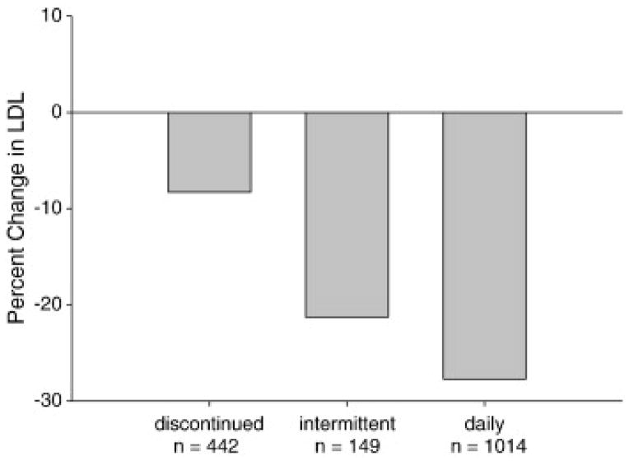
Intolérance aux statines et efficacité du dosage intermittent des statines avec réduction du LDL-C
Intermittent statin dosing may result in significant reduction in LDL-C¹
Estimated proportion of patients confirmed
to have statin intolerance²
LDL-C, low density lipoprotein cholesterol
1. Mampuya WM. Am Heart J. 2013;166(3):597–603;
2. Rosenson RS, et al. Cardiovasc Drugs Ther. 2017;31(2):187–95

Slide 79
Question
Quelle serait votre stratégie de traitement pour ce patient?
A. Réduire la dose d'atorvastatine
B. Passer de l'atorvastatine à la simvastatine 80 mg/jour
C. Au lieu de l'atorvastatine, commencer par une rosuvastatine à faible dose
D. Si la valeur cible du LDL-C n'est pas atteinte avec une faible dose de rosuvastatine, changer et prescrire une faible dose de rosuvastatine + ézétimibe
LDL-C, low density lipoprotein cholesterol

Slide 80
Question
Quelle serait votre stratégie de traitement pour ce patient?
A. Réduire la dose d'atorvastatine
B. Passer de l'atorvastatine à la simvastatine 80 mg/jour
C. Au lieu de l'atorvastatine, commencer par une rosuvastatine à faible dose
D. Si la valeur cible du LDL-C n'est pas atteinte avec une faible dose de rosuvastatine, changer et prescrire une faible dose de rosuvastatine + ézétimibe
LDL-C, low density lipoprotein cholesterol

Slide 81
Cas 3: Conclusions
L’intolérance aux statines est l'incapacité de tolérer au moins deux statines différentes - une statine à la dose quotidienne de départ, la plus faible et une deuxième statine à n'importe quelle dose¹
Un diagnostic efficace et une distinction des effets secondaires liés aux statines des autres conditions sont nécessaires pour éviter l'arrêt inutile des statines²
Approches possibles: commencer par une autre statine à faible dose - rechallenge, la rosuvastatine à une très faible dose (2,5 - 5 mg / jour), la rosuvastatine 5 - 10 mg tous les deux jours^{1,3}
L’ézétimibe est recommandé comme traitement supplémentaire avec une dose de rosuvastatine très faible ou en cas d’intolérance aux statines³
Chez les patients présentant une intolérance confirmée aux statines ou chez les patients pour lesquels une statine est contre-indiquée, l’ézétimibe doit être envisagé⁴
1. Gulizia MM, et al. Eur Heart J Suppl. 2017;19 (Suppl. D):D55–D63; 2. Di Stasi SL, et al. Phys Ther. 2010;90(10):1530–42; 3. Jacobson TA, et al. J Clin Lipidol. 2014;8:473–88; 4. Mach F, et al. Eur Heart J. 2019;0:1–78

Slide 82
Cas 4

Slide 83
Cas 4: DT2 avec NSTEMI récent
Données patient
Démographie | 57 ans, femme
Antécedents cliniques et familiaux | La Patiente a eu un NSTEMI il y a 3 jours
Facteurs de risque CV | Hypertension, fumeuse 10 cigarettes par jour pendant 25 ans; le père a eu un IM à l’âge de 52 ans et un frère aîné, qui est également un patient diabétique, a eu un pontage coronarien ( CABG ) à l’äge de 49 ans
Labo | LDL-C = 95 mg/dL, HDL-C = 33 mg/dL, TG = 170 mg/dL, HbA_{1C} = 7.2%, créatinine = 106.08 mmol/L (1.2 mg/dL), eGFR = 50 mL/min/1.73m² (CKD-EPI)
Traitement | Atorvastatine 10 mg depuis 5 ans, olmesartan/amlodipine 20 mg/5 mg, metformin XR 1 g, empagliflozin 10 mg
Résultat | A été soumise à une intervention coronaire percutanée dans l'artère coronaire droite, 50% de lésion dans la LAD, 70% circonflexe gauche, fonction ventriculaire normale. Quitte l’hôpital avec aspirine + clopidogrel et traitement antihypertenseur et antidiabétique
Follow-up | Comment contrôler les lipides?
Very high-risk individual
Residual mixed dyslipidaemia with low HDL-C despite use of low-dose statin
Persists smoking, CKD stage 3a
CABG, coronary artery bypass graft; CKD-EPI, Chronic Kidney Disease Epidemiology Collaboration; eGFR, epidermal growth factor receptor; HbA_{1c}, haemoglobin A1c; HDL-C, high-density lipoprotein cholesterol;
LDL-C, low-density lipoprotein cholesterol; LAD, left anterior descending; MI, myocard infarct; NSTEMI, non-ST segment elevation myocardial infarction; DT2, diabetes mellitus type 2 ; TG, triglyceride; XR, extended release

Slide 84
Risque d’ASCVD récurrent: IMPROVE-IT
N=17,717 post-ACS
7-year follow-up
Diabetes + hypertension
+ smoking + CKD 3a = 4 points
ACS, acute coronary syndrome; ASCVD, atherosclerotic cardiovascular disease; CHF, chronic heart failure;
DM, diabetes mellitus; EZ, ezetimibe; HTN, hypertension; iCVA, ischaemic cerebrovascular accident; PAD, peripheral artery disease
Bohula EA, et al. JACC. 2017;69:911–21

Slide 85
Question de sondage
Quelles sont les cibles LDL-C recommandées?
A. LDL-C <55 mg/dL (<1.4 mmol/L)
B. LDL-C <70 mg/dL (<1.8 mmol/L)
C. LDL-C <100 mg/dL (<2.6 mmol/L)
D. The lower the better
LDL-C, low density lipoprotein cholesterol

Slide 86
Question de sondage
Quelles sont les cibles LDL-C recommandées?
A. LDL-C <55 mg/dL (<1.4 mmol/L)
B. LDL-C <70 mg/dL (<1.8 mmol/L)
C. LDL-C <100 mg/dL (<2.6 mmol/L)
D. The lower the better
LDL-C, low density lipoprotein cholesterol

Slide 87
ESC/EAS 2019 recommended LDL-C goals
Recommendations | Class* | Level†
In secondary prevention for patients at very-high risk, an LDL-C reduction of ≥50% from baseline and an LDL-C goal of <1.4 mmol/L (55 mg/dL) are recommended | I | A
In primary prevention for individuals at very-high risk, an LDL-C reduction of ≥50% from baseline and an LDL-C goal of <1.4 mmol/L (<55 mg/dL) are recommended | I | C
In patients at high risk, an LDL-C reduction of ≥50% from baseline and an LDL-C goal of <1.8 mmol/L (<70 mg/dL) are recommended | I | A
LDL-C, low density lipoprotein cholesterol
*Class of recommendation; †Level of evidence
Mach F, et al. Eur Heart J. 2019;0:1–78

Slide 88
Uncontrolled ASCVD risk factors in Europe:
30-year evolution in EUROASPIRE
Percentage of individuals with uncontrolled atherosclerotic cardiovascular disease risk factor at interview
30% only
EA, EUROASPIRE
Santos RD. Eur J Prevent Cardiol. 2019;26:820–3

Slide 89
Question
Comment gérer le risque?
A. Arrêt du tabac + ézétimibe 10 mg
B. Arrêt du tabac + switch à une statine de haute intensité + ézétimibe
C. Arrêt du tabac + titration à l’atorvastatine 80 mg
D. Arrêt du tabac + atorvastatine 40 mg + fenofibrate 160 mg

Slide 90
Question
Comment gérer le risque?
A. Arrêt du tabac + ézétimibe 10 mg
B. Arrêt du tabac + switch à une statine de haute intensité + ézétimibe
C. Arrêt du tabac + titration à l’atorvastatine 80 mg
D. Arrêt du tabac + atorvastatine 40 mg + fenofibrate 160 mg

Slide 91
T2DM with recent NSTEMI
Recommendations for the treatment of dyslipidaemia in diabetes | Class* | Level†
In patients with type 2 diabetes at very-high risk, an LDL-C reduction of ≥50% from baseline and an LDL-C goal of <1.4 mmol/L (<55 mg/dL) is recommended | I | A
In patients with type 2 diabetes at high risk, an LDL-C reduction of ≥50% from baseline and an LDL-C goal of <1.8 mmol/L (<70mg/mL) is recommended | I | A
Statins are recommended in patients with type 1 diabetes who are at high or very-high risk | I | A
Intensification of statin therapy should be considered before the introduction of combination therapy | IIa | C
If the goal is not reached, statin combination with ezetimibe should be considered | IIa | B
Statin therapy is not recommended in pre-menopausal patients with or without diabetes mellitus who are considering pregnancy, or not using adequate contraception | III | C
Statin therapy may be considered in both type 1 diabetes and type 2 diabetes patients aged ≥30 years with evidence of end organ damage and/or an LDL-C level >2.5 mmol/L, as long as pregnancy is not being planned | IIb | C
LDL-C, low density lipoprotein cholesterol; NSTEMI, non-ST segment elevation myocardial infarction; T2DM, type 2 diabetes mellitus
*Class of recommendation; †Level of evidence
Mach F, et al. Eur Heart J. 2019;0:1–78

Slide 92
Réduction supplémentaire du LDL-C et reduction des événements ASCVD chez les patients diabétiques post-ACS en fonction du # de facteurs de risque: IMPROVE-IT
N = 4,933
Baseline:
LDL-C = 2.29 mmol/L
(89 mg/dL)
On treatment:
1.26 mmol/L
(49 mg/dL)
vs
1.72 mmol/L (67 mg/dL)
Giugliano RP, et al. Circulation. 2018;137:1571–82
ARR, absolute risk reduction; ASCVD, atherosclerotic cardiovascular disease HR, hazard ratio; ITT, intention-to-treat; LDL-C, low density lipoprotein cholesterol

Slide 93
Cas 5

Slide 94
Cas 5: Patient AW
Données patient
Démographie | 50 ans, homme
Raison de la consultation | Asymptomatique, veut un examen avant de commencer un programme d’entraînement physique
Antécedents familiaux | blanco
Facteurs de risque CV | Fumeur 10 cigarettes/jour
Labo | PA = 140/86 mmHg, IMC = 25 kg/m², CT = 255 mg/dL, LDL-C = 180 mg/dL, HDL-C = 50 mg/dL, TG = 125 mg/dL, NON-HDL-C = 230 mg/dL, Lp(a) = 40 mg/dL, Glucose = 91 mg/dL
Quel est son risque cardiovasculaire total?
Comment interprétez-vous son profil lipidique?
HDL-C, high-density lipoprotein cholesterol; LDL-C, low-density lipoprotein cholesterol; TG, triglyceride; PA, pression artérielle; IMC, Indice masse corporelle; CT, cholesterol total, Lp(a), lipoprotein a

Slide 95
SCORE chart for European populations at low
cardiovascular disease risk
SCORE Cardiovascular Risk Chart
10-year risk of fatal CVD
Low-risk regions of Europe
Systolic blood pressure (mmHg)
WOMEN
MEN
Non-smoker
Smoker
Age
Non-smoker
Smoker
180 | 1 | 1 | 1 | 1 | 2 | 2 | 2 | 3
160 | 0 | 0 | 1 | 1 | 1 | 1 | 1 | 2
140 | 0 | 0 | 0 | 0 | 1 | 1 | 1 | 1
120 | 0 | 0 | 0 | 0 | 0 | 0 | 0 | 1
 | 4 | 5 | 6 | 7 | 4 | 5 | 6 | 7
2 | 2 | 3 | 3 | 4 | 5 | 5 | 6
1 | 1 | 2 | 2 | 2 | 3 | 3 | 4
1 | 1 | 1 | 1 | 1 | 2 | 2 | 3
0 | 1 | 1 | 1 | 1 | 1 | 1 | 2
4 | 5 | 6 | 7 | 4 | 5 | 6 | 7
50
Total cholesterol (mmol/L) x 38,67 = mg/dL
 | <3% |  | 3-4% |  | 5-9% |  | ≥10%

Slide 96
Facteurs pouvant modifier le risque de SCORE – Mr. AW
- Classe sociale MOYENNE
- Obésité et obésité centrale NON - Inactivité physique NON
- Stress psychosocial Pas specifiquement
- Antécédents familiaux de maladie CV prématurée (homme < 55 ans; femme < 60 ans) NON
- Maladie mentale grave NON
- Maladies inflammatoires chroniques à médiation immunitaire NON
- Traitement de l’infection à VIH NON
- Syndrome d'apnée obstructive du sommeil NON
- Autres paramètres lipidiques : Lp(a), HDL-C, TG, NON
Notes:
Referentie toevoegen

Slide 97
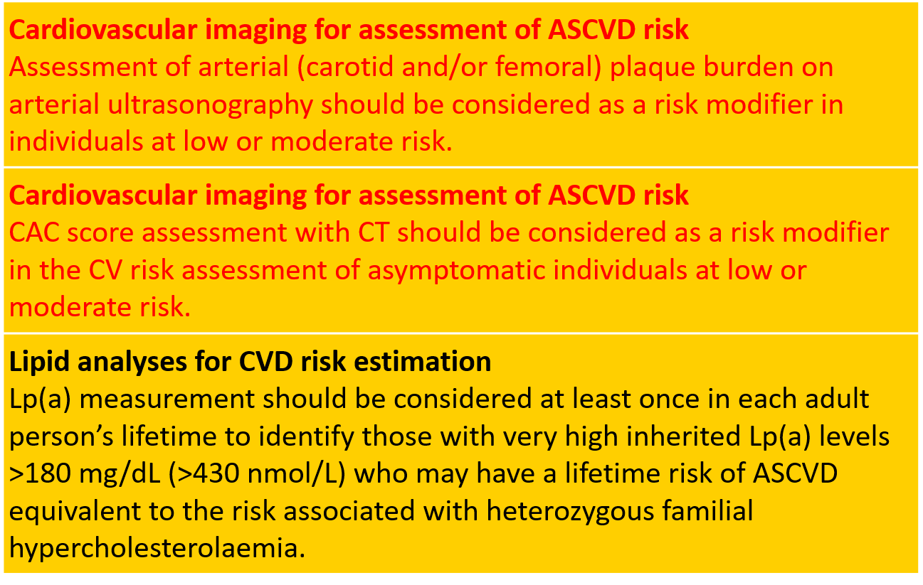
RISK ASSESSMENT - Imaging and Lp(a)

Slide 98
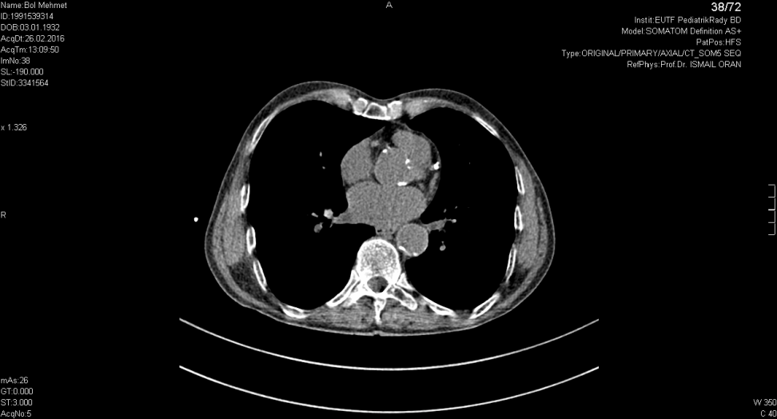
Cas 5 : Patient AW
Compte tenu du risque CV total ‘modérément augmenté’ (3%/10ans), un score de calcium via CT a été calculé.
Résultat: AGATSTON score de 522 .

Slide 99
Cumulative Incidence of Coronary Events:
MESA Study

Slide 100
Cas 5 : Patient AW
- Asymptomatique, le patient demande un check-up – veut suivre un programme d’entraînement physique
- Sa capacité d'exercice est testée sur un cycloergomètre.
Mr AW développe une douleur thoracique à son effort maximal et une dépression du ST importante dans les distractions ECG précordiales.
L’angiographie coronaire est recommandée

Slide 101
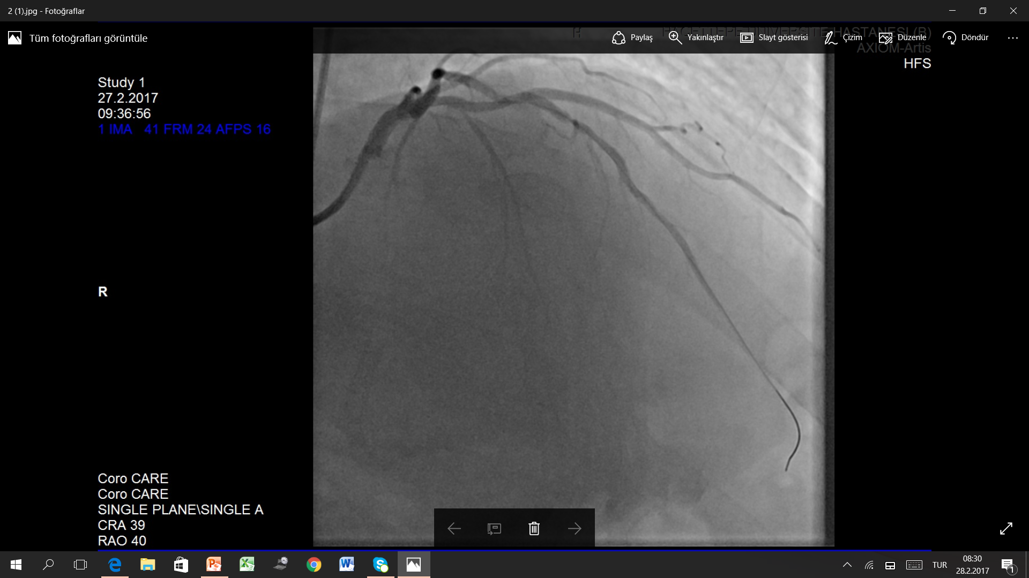
Cas 5 : L’angiographie coronaire

Slide 102
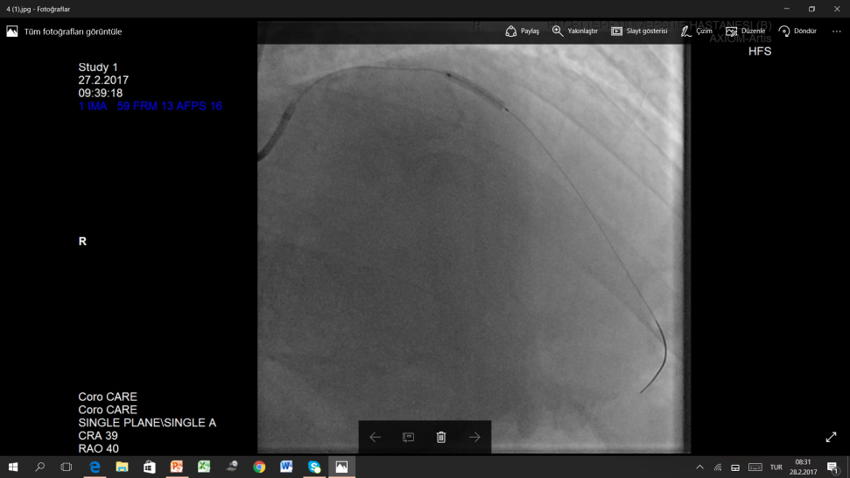

Cas 5 : Stenting du LAD réussi
LAD, left anterior descending

Slide 103
Cas 5 : Patient AW
Sort de l’hôpital avec une double thérapie antiplaquettaire et une statine.
Un programme de réadaptation cardiaque est recommandé avec une attention particulière au sevrage tabagique.
Quelle est sa valeur cible pour LDL-C?

Slide 104
Cas 5 : Patient AW - valeur cible pour LDL-C?
Souffrance coronaire prématurée + score Agatston accrue
= risque considérablement accru
Ligne directrice: Risque CV total fortement accru:
- une réduction du LDL-C d’au moins 50% de la valeur non traité et
- Une valeur cible LDL-C < 55 mg/dL
Mr. AW: LDL-C non traité: 180 mg/dL
valeur cible: < 55 mg/dL et au moins -50% = -125 mg/dL ou -69% de réduction
→ Commencez avec une dose élevée de statine de haute intensité en combinaison avec l’ézétimibe – un réduction de 70% au moyenne sera possible

Slide 105
Cas 6

Slide 106
Cas 6: Patient avec HF
Données patient
Démographie | 52 ans, femme
Antécedents cliniques et familiaux | Le père: décédé à l’âge de 50 ans Le frère: IM à 42 ans, taux de cholestérol élevé Asymptomatique, cholesterol élevé connu depuis 3 ans Profil lipidique initial: LDL-C= 317 mg/dL IMC= 24 kg/m², PA = 123/78 mmHg, tendon d’Achille épaissi
Traitement | Atorvastatine 40 mg depuis 3 ans
Labo | LDL-C = 185 mg/dL HDL-C = 52 mg/dL TG = 75 mg/dL
Follow-up | ?
IMC, Indice masse corporelle; PA, pression artérielle; FH, familial hypercholesterolaemia; HDL-C, high-density lipoprotein cholesterol; LDL-C, low-density lipoprotein cholesterol; MI, myocardial infarction; TG, triglyceride

Slide 107
Question
Quel serait votre stratégie thérapeutique?
Statine à haute intensité + combination avec ézétimibe
Suggérer un test génétique pour HF
Mesurer Lp(a)
Évaluer l’athérosclérose subclinique
Tout ce qui précède
FH, familial hypercholesterolaemia; Lp(a), lipoprotein(a)

Slide 108
Question
Quel serait votre stratégie thérapeutique?
Statine à haute intensité + combination avec ézétimibe
Suggérer un test génétique pour HF
Mesurer Lp(a)
Évaluer l’athérosclérose subclinique
Tout ce qui précède
FH, familial hypercholesterolaemia; Lp(a), lipoprotein(a)

Slide 109
Calcification de l’artère coronaire et des événements CV – HF traitée avec statines behandelde FH
206 molecularly proven HeFH individuals
Age 45±14 years
79.6% with high-dose statin
64% also with ezetimibe
On-treatment LDL-C 150±56 mg/dL
p=0.0003
CAC present in 105 individuals (51%)
Follow-up median of 3.7 (quartiles: 2.7–6.8) years
ASCVD events (7.2%)
Annualised event rate (1,000 patients/year)
CAC 0 = 0
CAC 1–100 = 26.4 (95% CI 12.9–51.8)
>100 = 44.1 (95% CI 26.0–104.1)
ASCVD, atherosclerotic cardiovascular disease; CAC, coronary artery calcium score; CI, confidence interval; HeFH, heterozygous familial hypercholesterolaemia; MACE, major adverse cardiac event
Miname MH, et al. JACC Cardiovasc Imaging. 2018 [Epub ahead of print]

Slide 110
Cas 6: Patient avec HF
Données patient
Démographie | 52 ans, femme
Antécedents cliniques et familiaux | Le père: décédé à l’âge de 50 ans Le frère: IM à 42ans, taux de cholesterol élevé Asymptomatique, cholesterol élevé connu depuis 3 ans Profil lipidique initial: LDL-C= 317 mg/dL IMC= 24 kg/m², PA = 123/78 mmHg, tendon d’Achille épaissi
CAC score | 2,300 Agatston units  Coronarographie  CABG
Analyse génétique | Hétérozygote HF confirmée par analyse génétique (duplication des exons 13 et 14 dans le gene du récepteur LDL)
Traitement | Rosuvastatine 20 mg + ézétimibe 10 mg
Profil lipidique | LDL-C = 135 mg/dL Lp(a) = 124 mg/dL
IMC, Indice masse corporelle; PA, pression artérielle; CABG, coronary artery bypass graft; FH, familial hypercholesterolaemia; LDL-C, low density lipoprotein cholesterol; Lp(a), lipoprotein (a); IM, infarctus du myocard

Slide 111
Cas 6: Patient avec HF
Quelle serait votre approche?
Switch à l’atorvastatine 80 mg + ézétimibe 10 mg
Augmentation de la rosuvastatine à 40 mg
Ajout d’un inhibiteur de PCSK9
Aphérèse du LDL
PCSK9, proprotein convertase subtilisin/kexin type 9

Slide 112
Cas 6: Patient avec HF
Quelle serait votre approche?
Switch à l’atorvastatine 80 mg + ézétimibe 10 mg
Augmentation de la rosuvastatine à 40 mg
Ajout d’un inhibiteur de PCSK9
Aphérèse du LDL
PCSK9, proprotein convertase subtilisin/kexin type 9

Slide 113
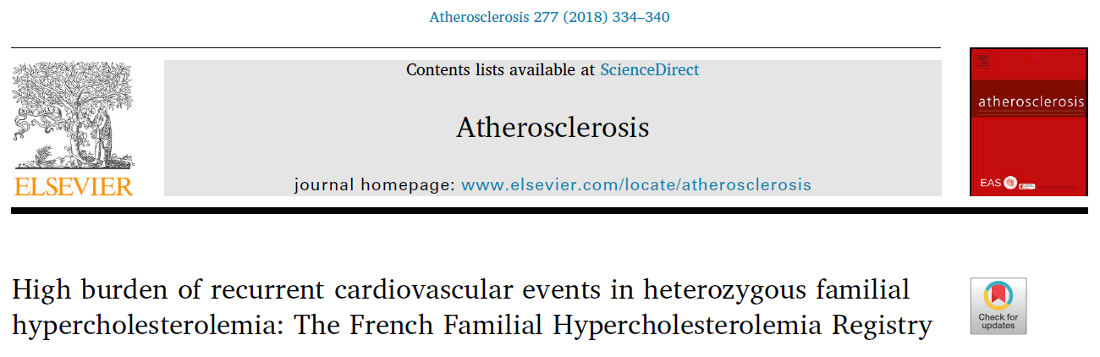
Patient avec HF
Key findings
First CV event occurred at the mean age of 47 years (72% male)
37% of patients had at least one recurrent CV event (mean of 1.8 events per patient)
CV, cardiovascular
Béliard S, et al. Atherosclerosis. 2018;277:334–40

Slide 114
Patient avec HF
Recommendations | Class* | Level†
It is recommended that a diagnosis of FH is considered in patients with CHD aged <55 years for men and <60 years for women, in people with relatives with premature fatal or non-fatal CVD, in people with relatives having tendon xanthomas, in people with severely elevated LDL-C levels [in adults >5 mmol/L (<190 mg/dL)], in children >4 mmol/L (>150 mg/dL)], and in first-degree relatives of FH patients | I | C
It is recommended that FH is diagnosed using clinical criteria and confirmed, when possible, with DNA analysis | I | C
Once the index case is diagnosed, family cascade screening is recommended | I | C
It is recommended that FH patients with ASCVD or who have another major risk factor are treated as very-high-risk, and those with no prior ASCVD or other risk factors as high-risk | I | C
For FH patients with ASCVD who are at very-high risk, treatment to achieve a ≥50% reduction from baseline and an LDL-C <1.4 mmol/L (<55 mg/dL) is recommended. If goals cannot be achieved, a drug combination is recommended | I | C
Treatment with a PCSK9 inhibitor is recommended in very-high risk FH patients if the treatment goal is not achieved on a maximal tolerated statin plus ezetimibe | I | C
In children, testing for FH is recommended from the age of 5 years, or earlier if HoFH is suspected | I | C
ASCVD, atherosclerotic cardiovascular disease; CHD, coronary heart disease; HoFH, homozygous familial hypercholesterolaemia; LDL-C, low density lipoprotein cholesterol; PCSK9, proprotein convertase subtilisin/kexin type 9; *Class of recommendation; †Level of evidence
Mach F, et al. Eur Heart J. 2019;0:1–78

Slide 115
Dutch Lipid Clinic Network diagnostic criteria for
familial hypercholesterolaemia (1)
Criteria | Points
1) Family history
First-degree relative with known premature (men <55 years; women <60 years) coronary or vascular disease, or first-degree relative with known LDL-C above the 95th percentile | 1
First-degree relative with tendinous xanthomata and/or arcus cornealis, or children <18 years of age with LDL-C above the 95th percentile | 2
2) Clinical history
Patient with premature (men <55 years; women <60 years) coronary artery disease | 2
Patient with premature (men <55 years; women <60 years) cerebral or peripheral vascular disease | 1

Slide 116
Dutch Lipid Clinic Network diagnostic criteria for
familial hypercholesterolaemia (2)
Criteria | Points
3) Physical examinationª
Tendinous xanthomata | 6
Arcus cornealis before age 45 years | 4
4) LDL-C levels (without treatment)
LDL-C ≥8.5 mmol/L (≥325 mg/dL) | 8
LDL-C 6.5–8.4 mmol/L (251–325 mg/dL) | 5
LDL-C 5.0–6.4 mmol/L (191–250 mg/dL) | 3
LDL-C 4.0–4.9 mmol/L (155–190 mg/dL) | 1
ª Exclusive of each other (i.e. maximum 6 points if both are present).

Slide 117
Dutch Lipid Clinic Network diagnostic criteria for
familial hypercholesterolaemia (3)
Criteria | Points
5) DNA analysis
Functional mutation in the LDLR, ApoB or PCSK9 genes | 8
Choose only one score per group, the highest applicable (diagnosis is based on the total number of points obtained)
A ‘definite’ FH diagnosis requires >8 points pt HF 22 points
A ‘probable’ FH diagnosis requires 6–8 points
A ‘possible’ FH diagnosis requires 3–5 points

Slide 118
Patient avec HF
Recommandations
Le traitement doit être débuté par un traitement aux statines très intensif, généralement en association avec l'ézétimibe¹
Une association avec un inhibiteur PCSK9 est recommandée pour les patients HF à très haut risque (ie avec ASCVD ou avec un autre facteur de risque important) qui n'atteignent pas leur objectif d'une dose maximale tolérée de statine et d'ézétimibe¹
Il est recommandé de déterminer « le profil de risque » notamment le profil lipidique de toutes les personnes relatives au premier degré (cascade screening)
1. Mach F, et al. Eur Heart J. 2019;0:1–78
ASCVD, atherosclerotic cardiovascular disease; FH, familial hypercholesterolaemia; PCSK9, proprotein convertase subtilisin/kexin type 9

Slide 119
Résumé

Slide 120
Résumé et message à retenir
Lignes directrices ESC / EAS 2019 sur la dyslipidémie
Les directives 2019 ESC / EAS sur la dyslipidémie ont fixé de nouveaux objectifs pour la réduction du LDL-C en fonction du risque CV et, dans de nombreux cas, recommandent une thérapie combinée pour atteindre la valeur cible et ≥50% de réduction
Cas patients
L'évaluation du risque de maladie CV fatale sur 10 ans est illustrée sur la base des nouvelles cartes de risque cardiovasculaire SCORE.
L'intolérance aux statines n'est pas rare et si l'objectif LDL-C n'est pas atteint avec une faible dose de statine, l'ézétimibe est recommandé comme traitement supplémentaire
Chez les patients atteints de diabète de type 2 à très haut risque, une réduction du LDL-C ≥50% par rapport à la valeur initiale et un objectif LDL-C <55 mg/dL sont recommandés.
Pour les patients HF à très haut risque (c'est-à-dire avec ASCVD ou avec un autre facteur de risque important) qui n'atteignent pas leur objectif avec une dose maximale tolérée de statine et d'ézétimibe, une combinaison avec un inhibiteur PCSK9 est recommandée.
Key take-home
Les nouvelles directives permettront à plusieurs patients d'atteindre leur objectif de LDL-C grâce à l'utilisation correcte et opportune d'approches de thérapie combinée
ASCVD, atherosclerotic cardiovascular disease; CV, cardiovascular; FH, familial hypercholesterolaemia; LDL-C, low density lipoprotein cholesterol; PCSK9, proprotein convertase subtilisin/kexin type 9

